Slide 2
66 pages
Just an overview today

Slide 3
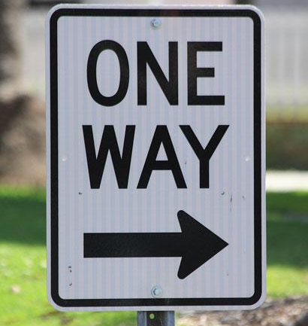
Goals of the Guide
Prognosticating
Instead we seek collaboration
ISO Standard
Instead we’ll contribute to ISO
Final Edition
Instead we’ll continue to revise
Notes:
Who is DT today
Phase One’s Largest Cultural Heritage and Commercial Partner world wide
Expanding into other Markets
Archives and Scietific
DT Scientific
New Space New York July 2018 Space expansion and East Coast Phase One DT resource center with a focus on training
New Space LA Jan 2019 Space Expansion
Why -- work with communities to develop solutions, share technologies and techniques
New Staff
Marketing Director
Support Staff NY and LA
More R&D / Application Specialists NY and LA
Why
Better Represent our companies Division
Documentation of tools and techniques
** Looking for an Events Manager
Website
Can no longer just a Phase One Dealership that serves only serves Commercial and CH market segments
DT -- Company Culture
Commercial
Cultural Heritage
Scientific
Archives

Slide 4
Goals of the Guide
User Manual
Step-by-Step for DT Gear
Discussion
Provide a framework for debate
A Good Start
Jumping-off point for your SOPs

Slide 5
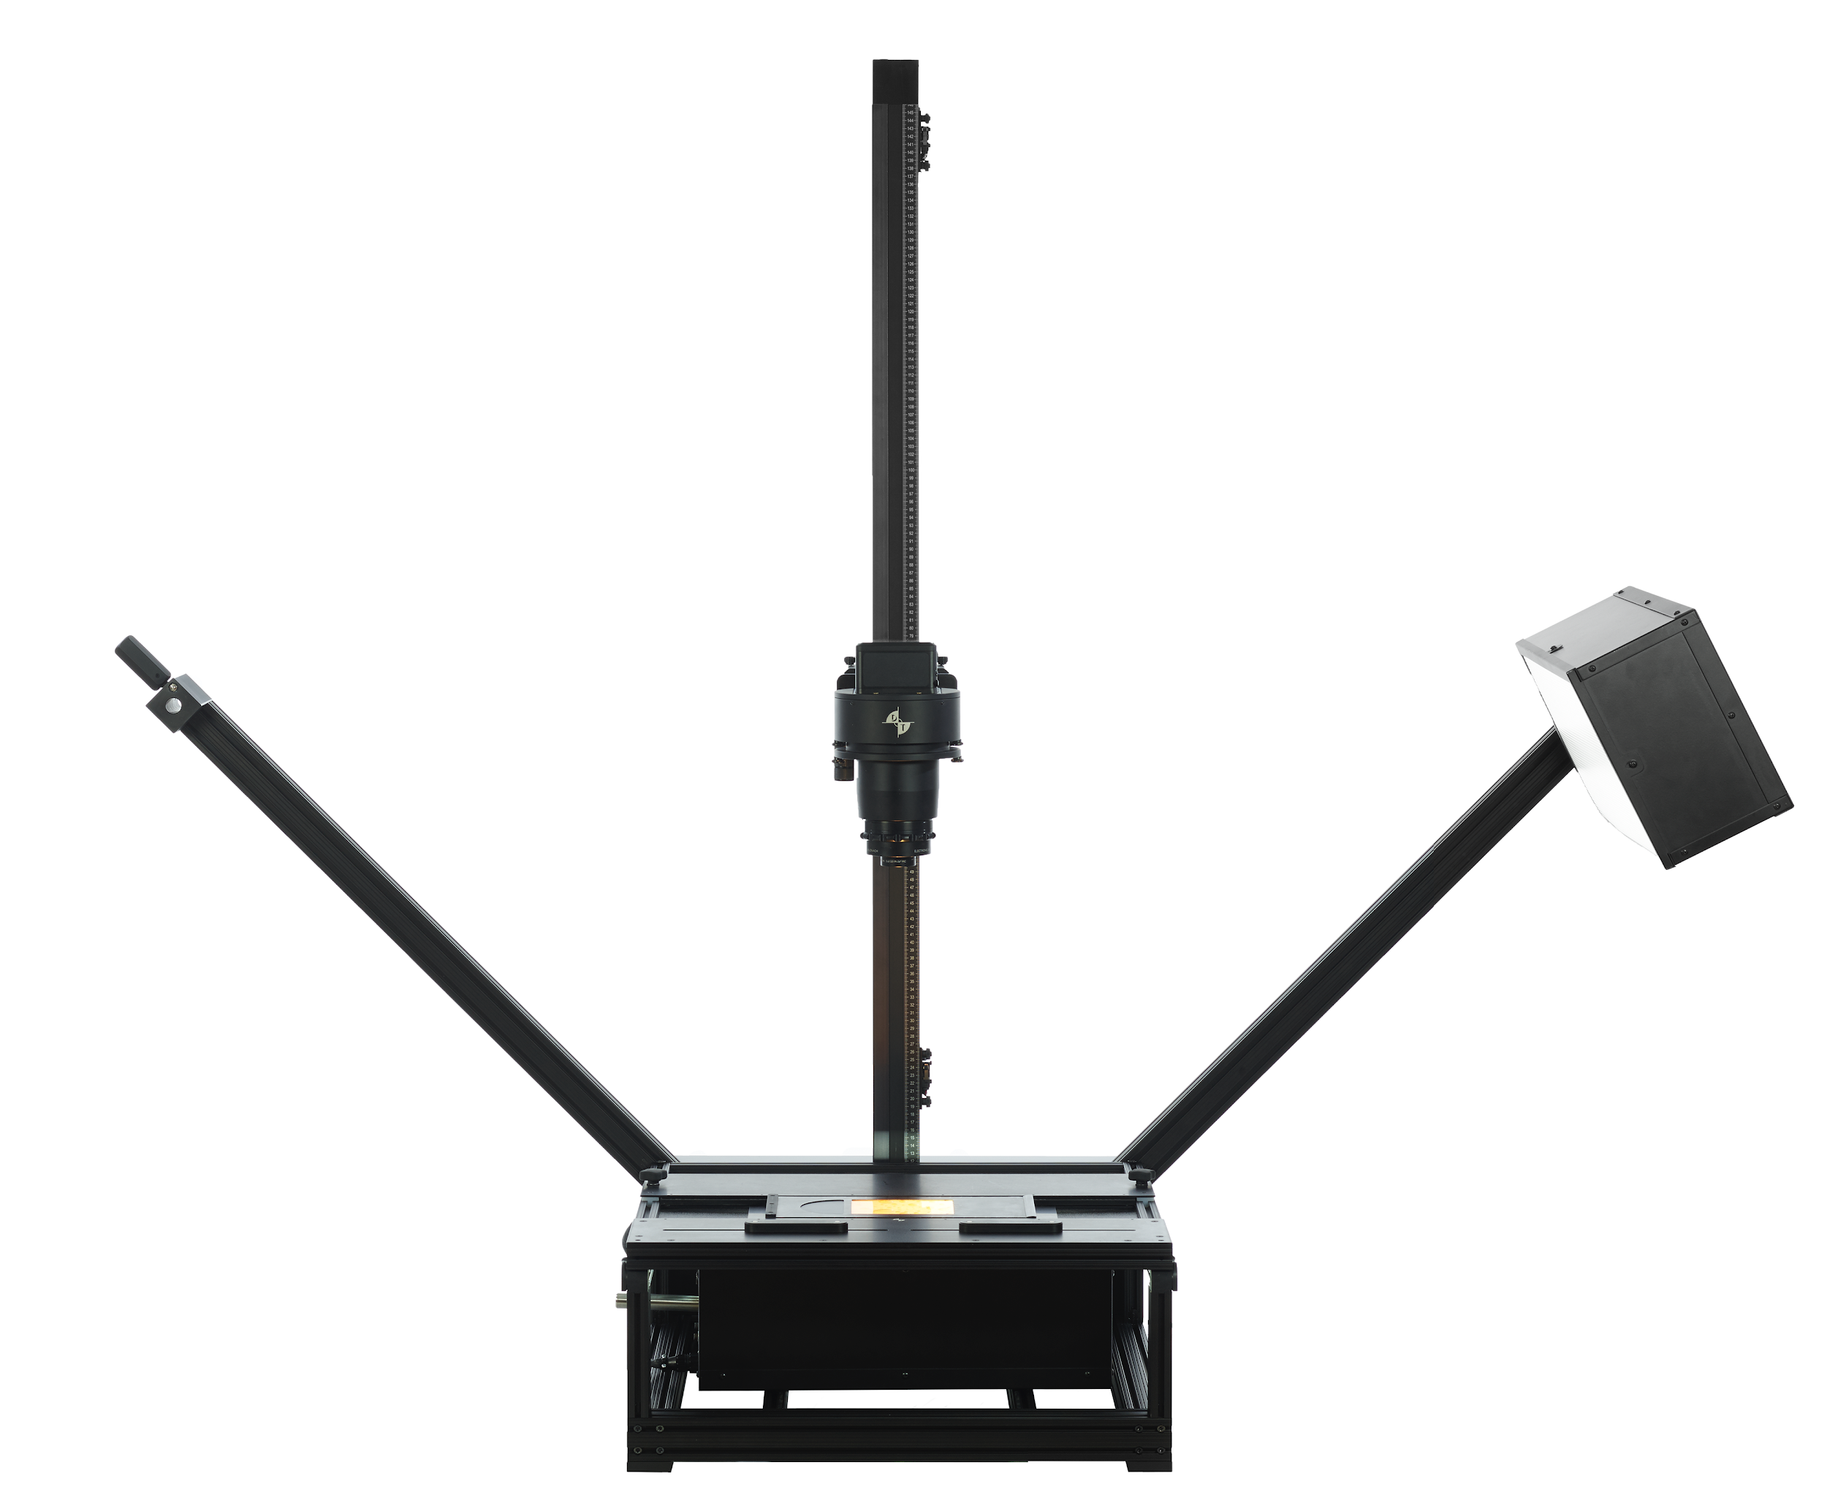
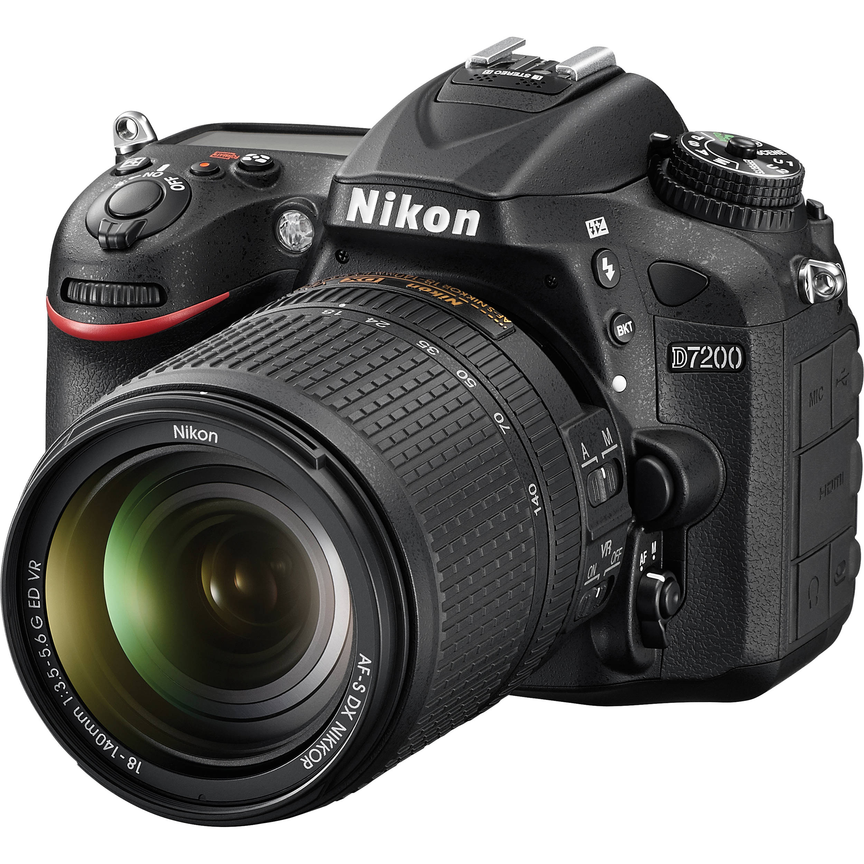
Goals of the Guide
Scanners | DT Systems | Cameras
Simple, Purpose Built | Best of Both | Fast, Flexible, Modern

Slide 6
Our Mission for transmissive materials
Digital surrogate for in-person viewing

Slide 7
Our Mission for transmissive materials
Help the viewer understand the object

Slide 8
Our Mission for transmissive materials
We need to do more.
We need to do it now.

Slide 9
Why Now?
Why now?
Deteriorating Condition
Loss of Context

Slide 10
Why Now? Physical Deterioration
“All photographic media is subject to degradation, both reflective and transmissive. However, transmissive media is especially susceptible to degradation of the base material. Nitrate and most forms of acetate based films are degrading.
Many films are past the point of saving, and many more are approaching that threshold.
Film to film duplication is no longer practical, it’s a lost art. Film to digital preservation-quality reformatting is the only option, and this is a true specialty requiring very sophisticated technique to truly capture the content of film materials.”
– Tom Rieger, Manager, Digitization Services Section, Library of Congress

Slide 11
Why Now? Physical Deterioration

Slide 12
Why Now?
Why now?
Deteriorating Condition
Loss of Context

Slide 13
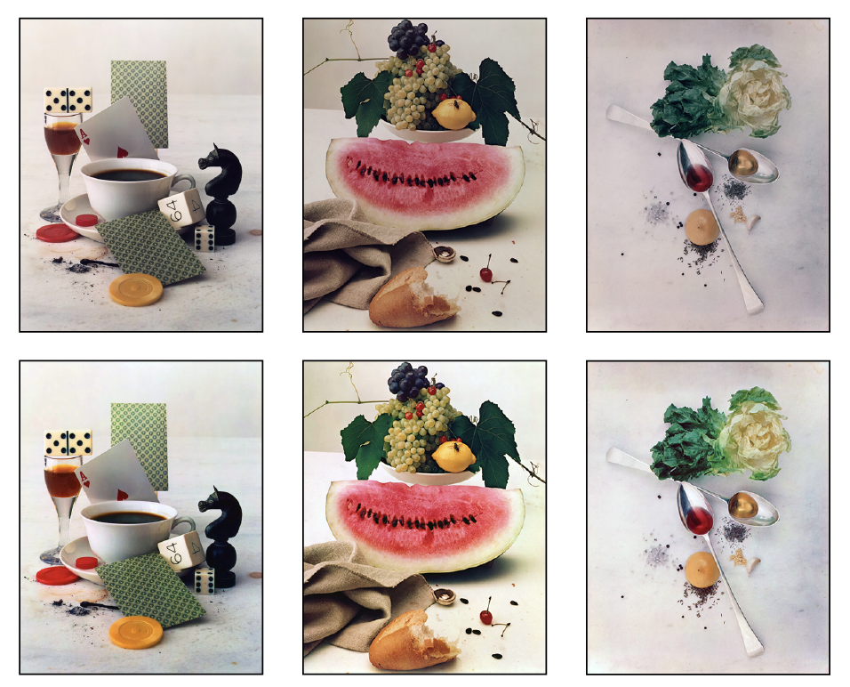
Why Now? Lost Aesthetic Context
Images from Irving Penn Foundation

Slide 14
Why Now? Lost Technical Context

Slide 15
Film Ecosystem The world was different then
Film
Processing
Enlargement
Paper
Finishing
Presentation

Slide 16
Film Ecosystem The world was different then
In-Camera Choices | Film Choices | Enlargement Choices | Print Choices | Presentation
Film Emulsion | Push or pull processing | Paper Type | On-Print Retouching | Frame
Lens Filters | Processing Chemistry | Paper Size | Chemical Toning (e.g. sepia) | Mat
 | On-film retouching | Crop | Chemical Dodge & Burn | Placement
 |  | Optical Dodge & Burn | Printing Chemistry | Illumination
 |  | Unsharp Mask

Slide 17
Why Now? Lost Aesthetic Context
“Given the many combinations of film processes and print media used over time, there is no way to reliably create a digital image from a negative that is a faithful reproduction of how the image may have looked if printed with the original materials and processes of the era. With this fundamental limitation, we are concerned that modern sensibilities of what an image should look like will lead to scans which lose the authenticity of the original in the quest for good looking images.”
– FADGI 2016

Slide 18
But we can’t do that! Excuses we don’t make elsewhere
Our understanding of the film ecosystem is middling today...
but it’s only downhill from here.

Slide 19
But we can’t do that! Excuses we don’t make elsewhere
Restoring a painting
Ancient city from ruins
Performance from sheet music
3D rendering from a blueprint
Notes:
The push back is “how do we know?” but museums, libraries, and archives do far more with far less information.

Slide 20
Our Mission for transmissive materials
Help the viewer understand the object

Slide 21
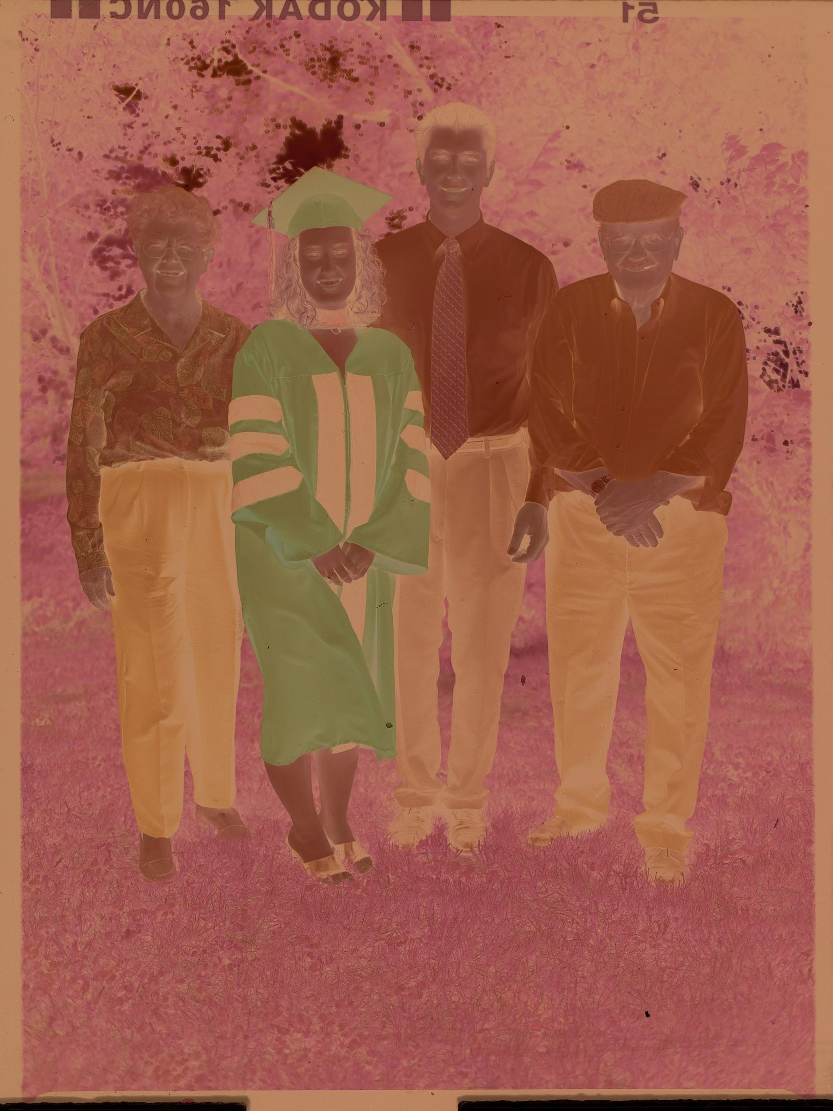
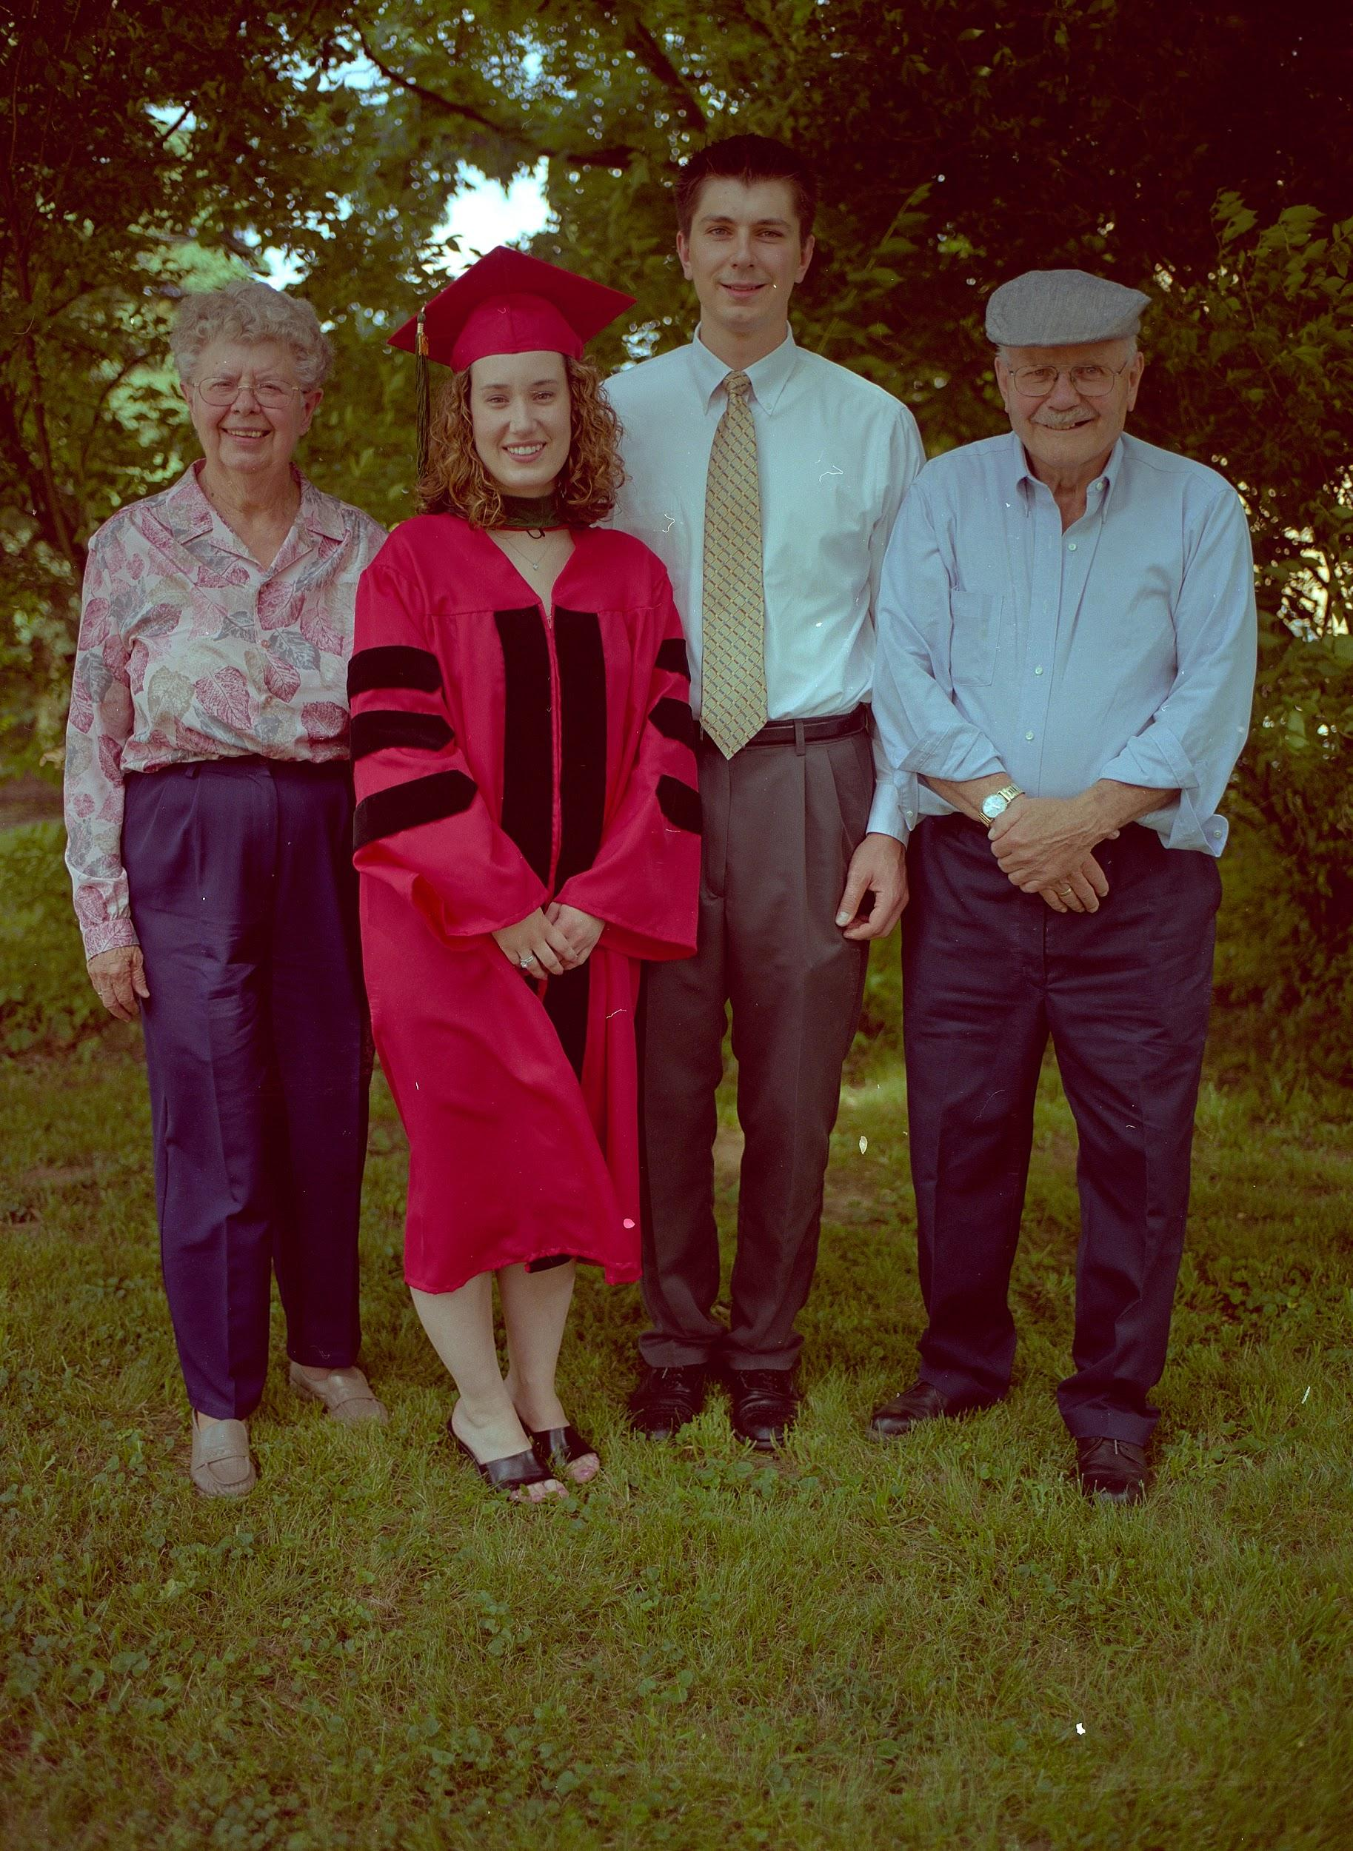
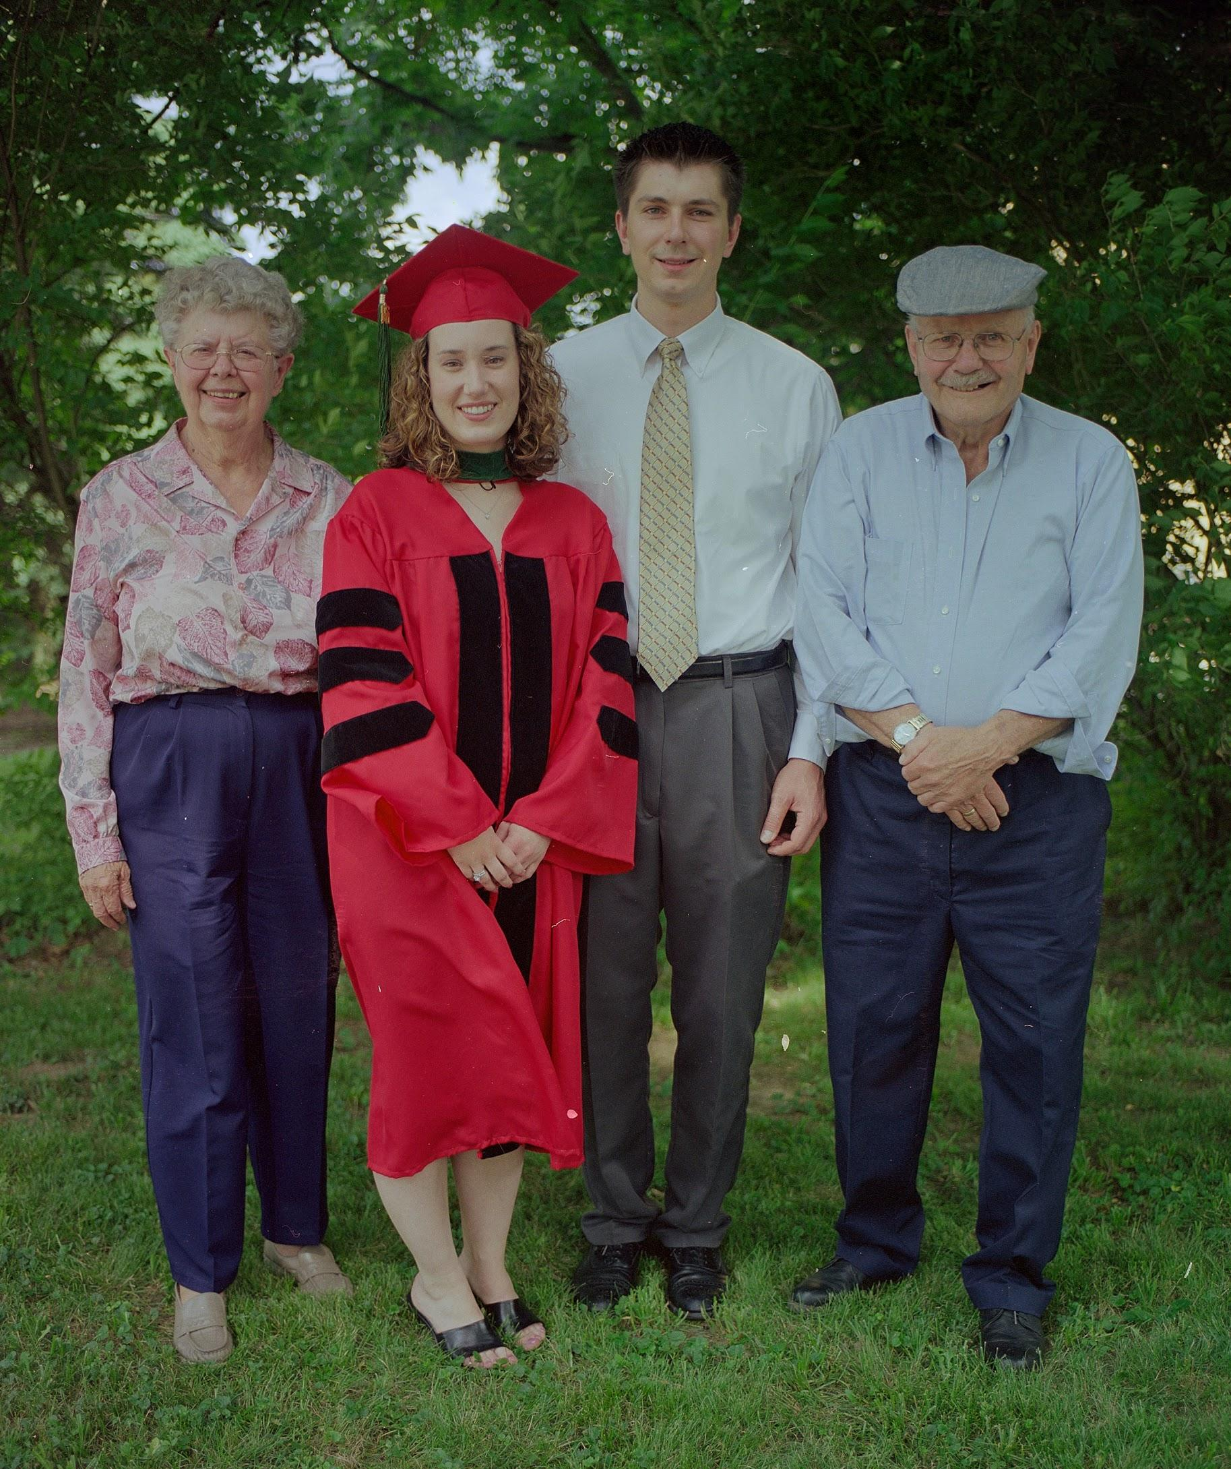
Work Product Suggested Names
 | Object Reproduction | Content Reproduction | Speculative Artist’s Intended Rendering
 | The Film as an Object | The Image in the Film | The Intended End Result

Slide 22
Work Product Capture Method
 | Object Reproduction | Content Reproduction | Speculative Artist’s Intended Rendering
Crop | Full object | The image area | As the artist would
WB on | Light source | Content | As the artist would
Expose for | Light source | Content | As the artist would

Slide 23
Work Product Corrections
 | Object Reproduction | Content Reproduction | Speculative Artist’s Intended Rendering
Dust / scratch | No adjustment | No adjustment | Remove where practical
Color / Tone | No adjustment | Adjust if necessary | As the artist would

Slide 24
Work Product Costs
 | Object Reproduction | Content Reproduction | Speculative Artist’s Intended Rendering
 | Very Low | Low | High

Slide 25
Work Product Value
 | Object Reproduction | Content Reproduction | Speculative Artist’s Intended Rendering
Audience | Conservators, Researchers Art Authenticators, Curators | Researchers General Public | Researchers General Public
Unique Value | Physical Condition Object Type Artist’s Capture Methods | Content Discovery | The way the artist intended

Slide 26
Bottom Line
Don’t let the perfect be the enemy of the good.

Slide 27
Feedback How you can help
Examples (raws)
Exceptions
Papers & Presentations
Other Advanced Techniques

Slide 28
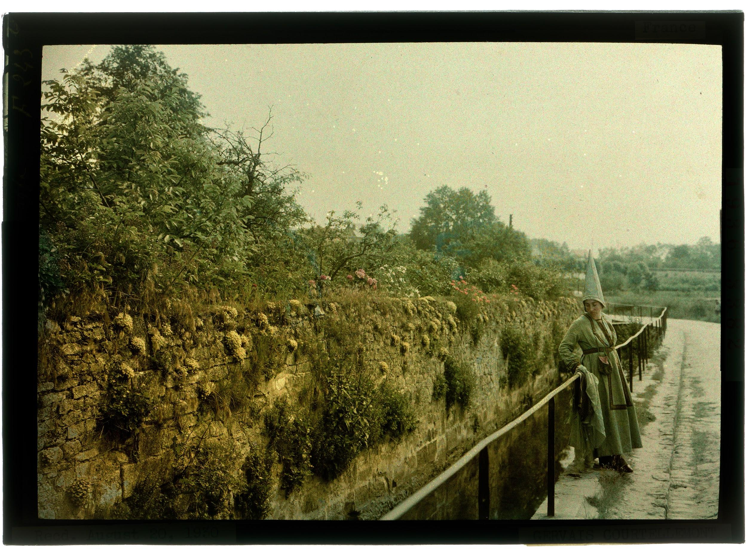
Feedback How you can help
Images Courtesy National Geographic Society

