Slide 1
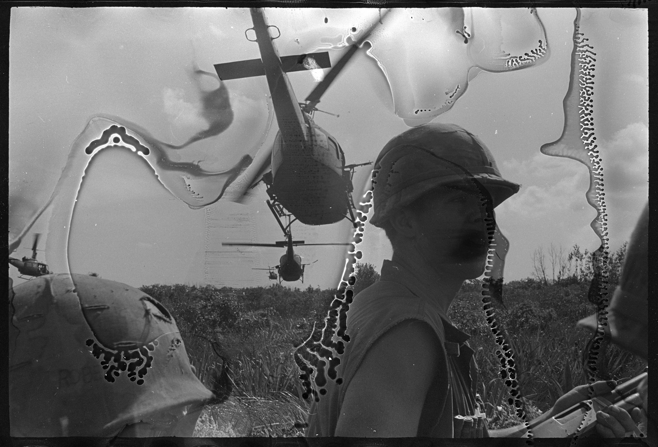

DECAY AND SAFETY
THE DIGITAL
CAPTURE OF FILM
dt culturalheritage west coast roundtable
march 2019
Overseas Weekly collection, Hoover Institution Library and Archives
Notes:
1st time here at a round table, looking forward to…
Digital capture of deteriorating film has many challenges.
hybrid photograph conservation / digitization company
many unusual and challenging deteriorated film projects

Slide 2
Overview
Film deterioration and health hazards
Care and capture of deteriorated film:
  What you can do TOMORROW
  What you can do LONG-TERM
  What you can OUTSOURCE
Notes:
Focus on:
typical deterioration issues and solutions
health and safety concerns
And how you might approach these:
TOMORROW & LONG-TERM
And what you might OUTSOURCE (to your conservation lab or to a vendor)

Slide 3
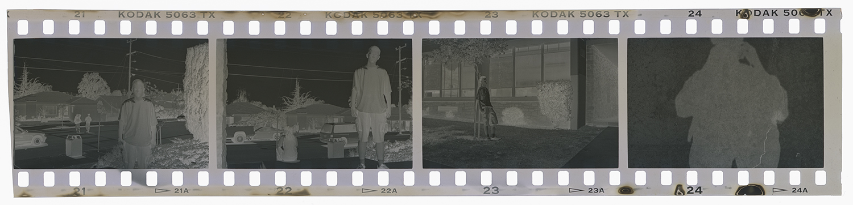
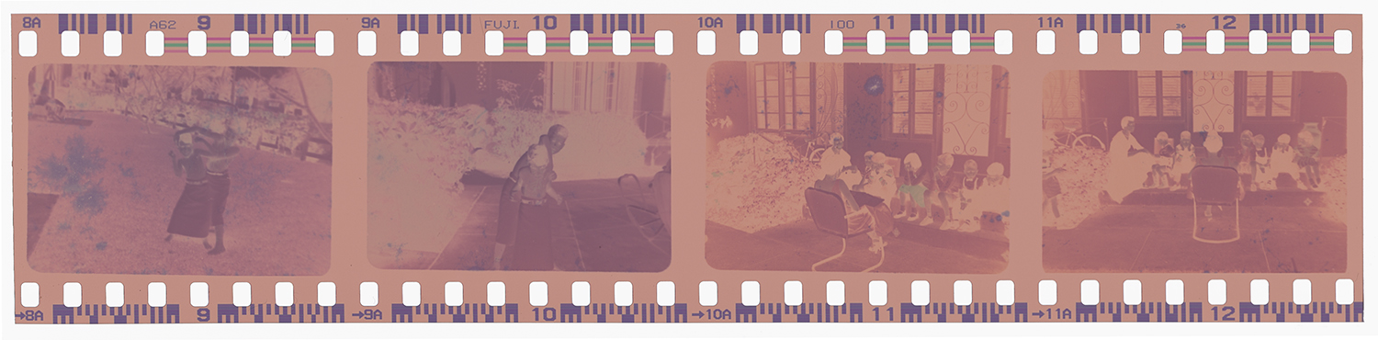
Film cross-sections
Silver particles in gelatin
B+W film
Color dyes in gelatin
Color film
Film base (plastic)
Anti-curl layer (gelatin)
Notes:
A good starting point is the structure of films–
since each component has its own weaknesses in terms of long-term preservation.

Slide 4
Film deterioration
Film base
  Cellulose nitrate
  Cellulose acetate
Image
  Silver
  Color dyes
Image Binder
  Gelatin
Decomposes
Discolors / fades / mirrors
Fades
Grows mold

Slide 5
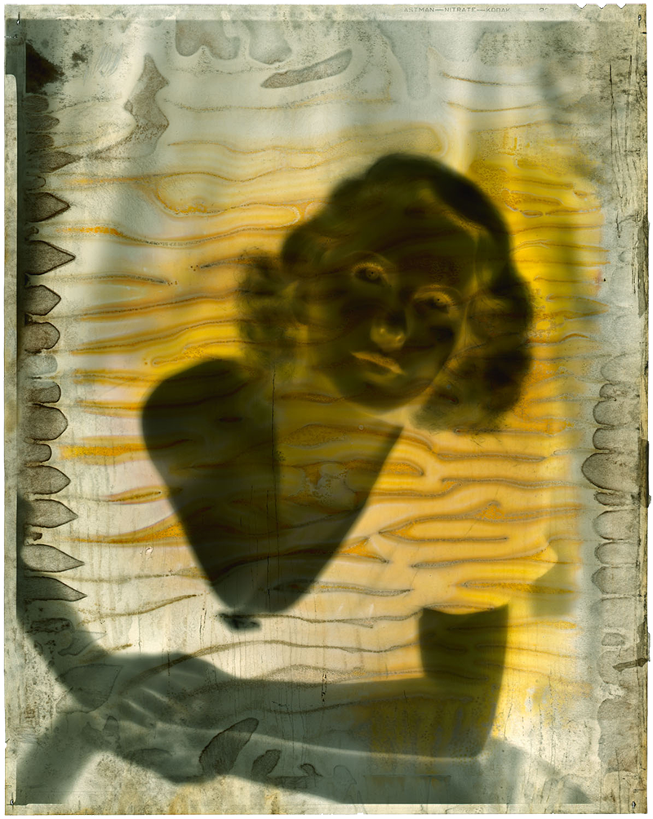
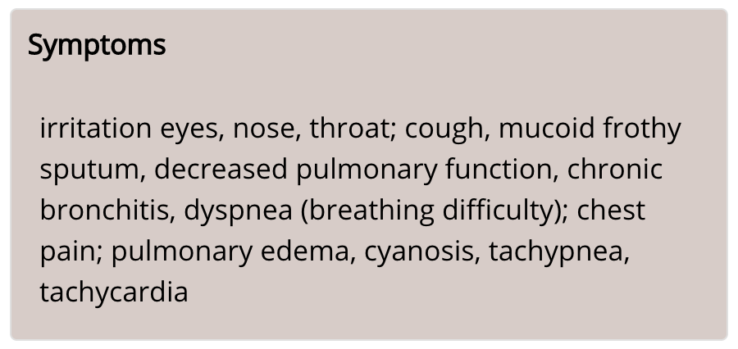
Nitrate film-base decomposition
Film becomes:
Toxic!
Embrittled
Yellow
Sticky
Non-existent
Nitrogen Dioxide Exposure Symptoms: irritation of eyes, nose, throat; cough; mucoid frothy sputum, decreased pulmonary function, chronic bronchitis, dyspnea (breathing difficulty); chest pain; pulmonary edema, cyanosis, tachypnea, tachycardia
Portrait of Jean Arthur, UCLA Special Collections
Notes:
Toxic
When it deteriorates, it’s VERY bad
Nitrate film is like the little
girl of the old nursery rhyme:
There Was a Little Girl
There was a little girl, Who had a little curl, Right in the middle of her forehead. When she was good, She was very good indeed, But when she was bad she was horrid. -- Henry Wadsworth Longfellow

Slide 6
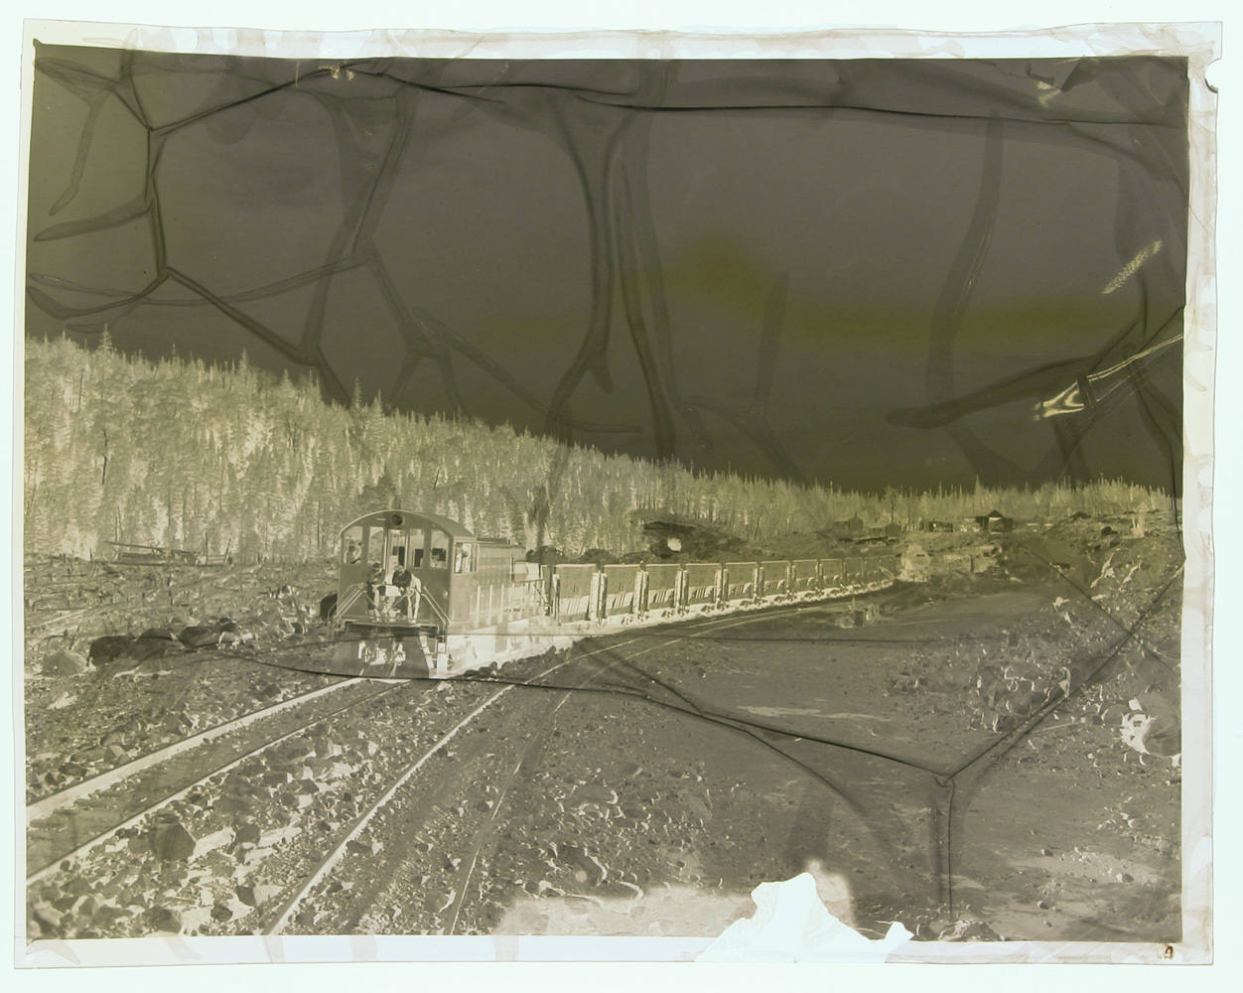
Acetate film-base decomposition
Film becomes:
Toxic!
Acidic
Embrittled
Shrunken
George Hunter, cellulose acetate negative, Library and Archives Canada
Notes:
Toxicity study published by the Arizona State Museum in 1987 “Deteriorating Negatives: A Health Hazard in Collection Management”
Personal injuries occurred during handling of nitrate and acetate films during duplication project.

Slide 7

Color dye fading
GWAC study collection
Late 1940s 5” x 7” color transparencies
Notes:
An important form of deterioration– but not related to human safety

Slide 8
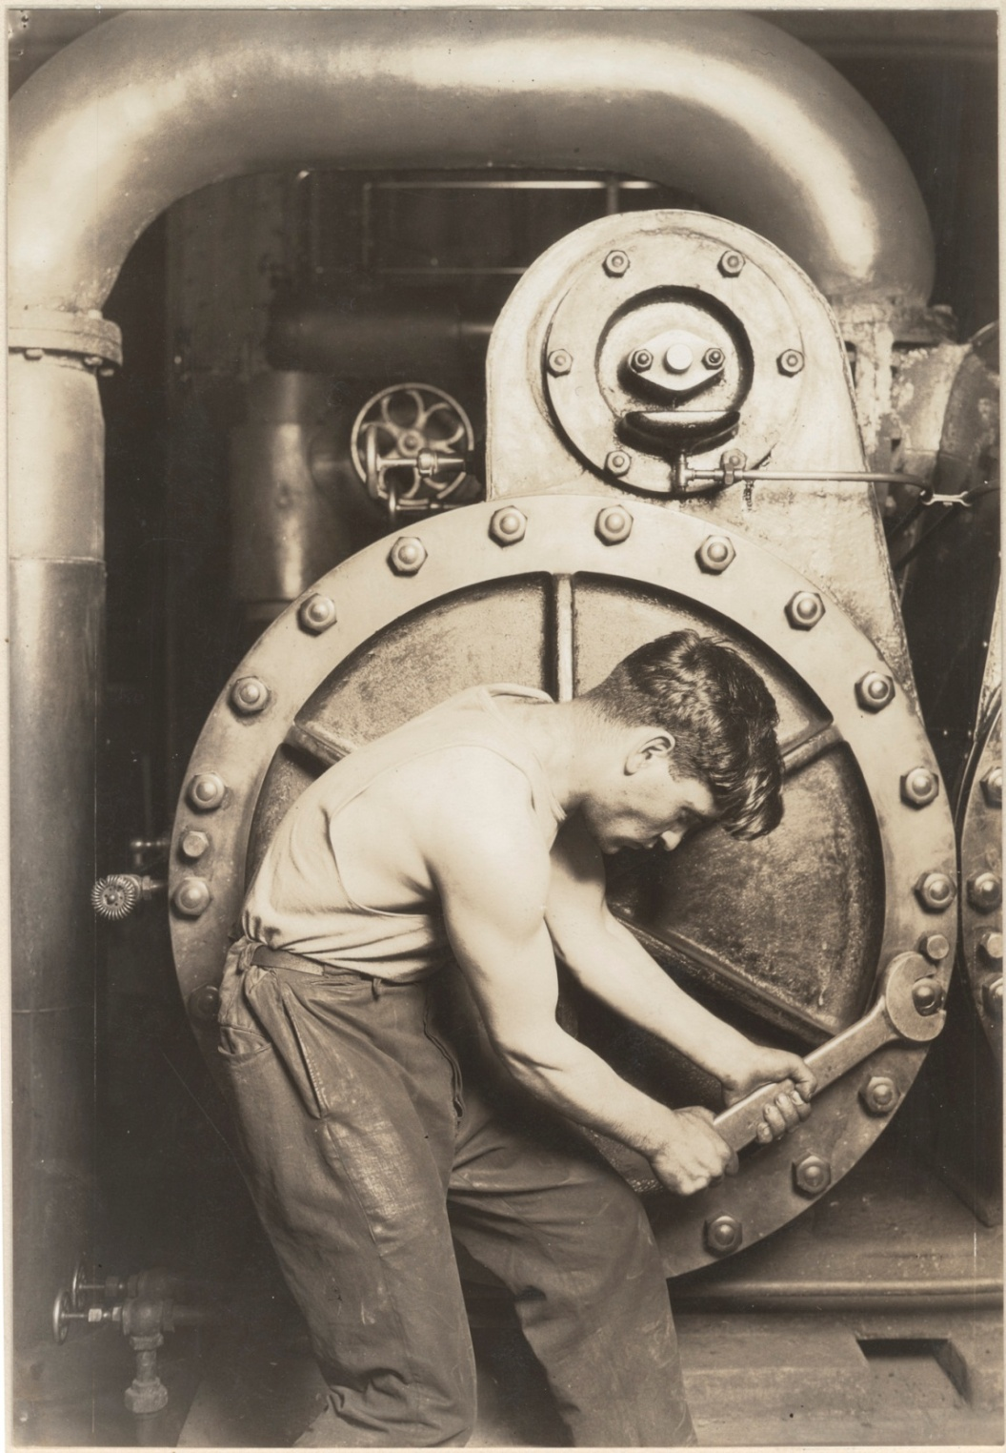
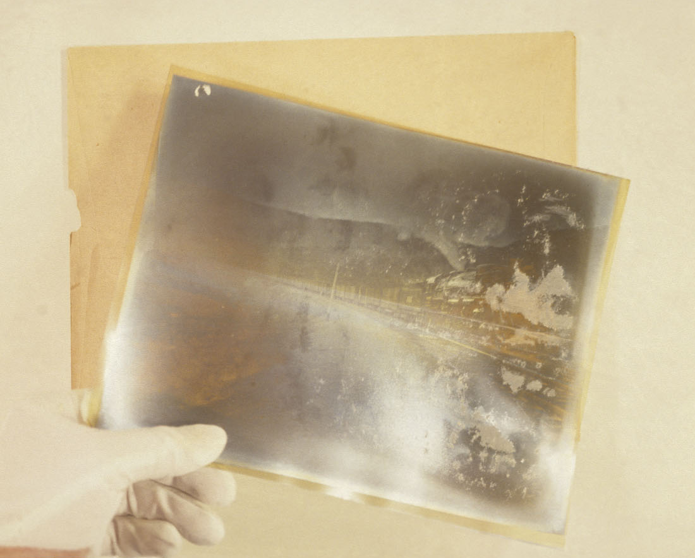
Silver image oxidation
Lewis Hine, George Eastman Museum
Silver image particle breakdown:
Silver-mirroring
Fading
Notes:
Typical highlight fading / loss of detail in gelatin silver prints not typically seen in B+W negatives
Silver mirroring is certainly seen, but doesn’t generally cause any issues in transmissive digital capture

Slide 9
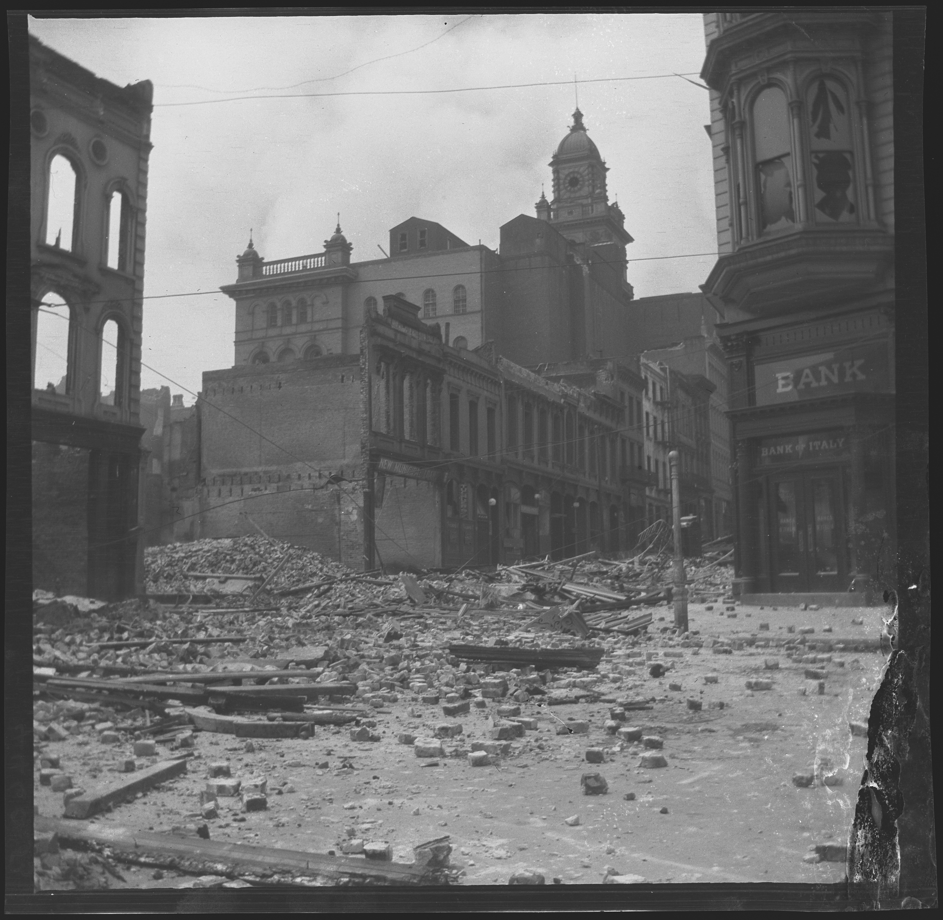
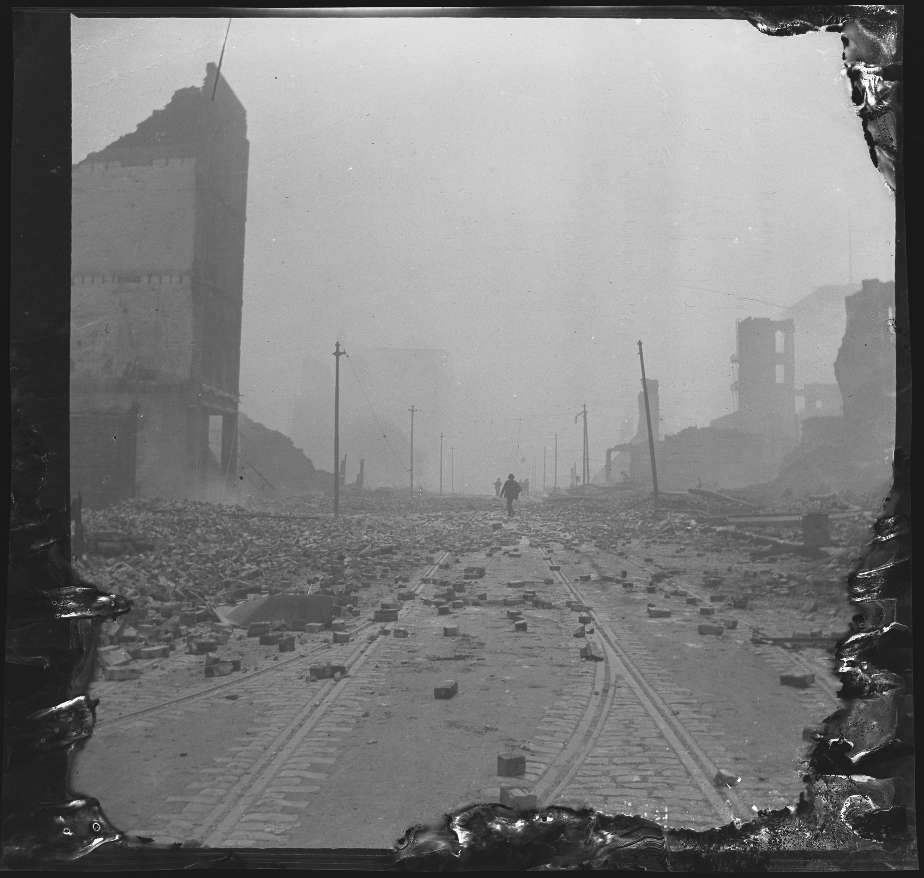
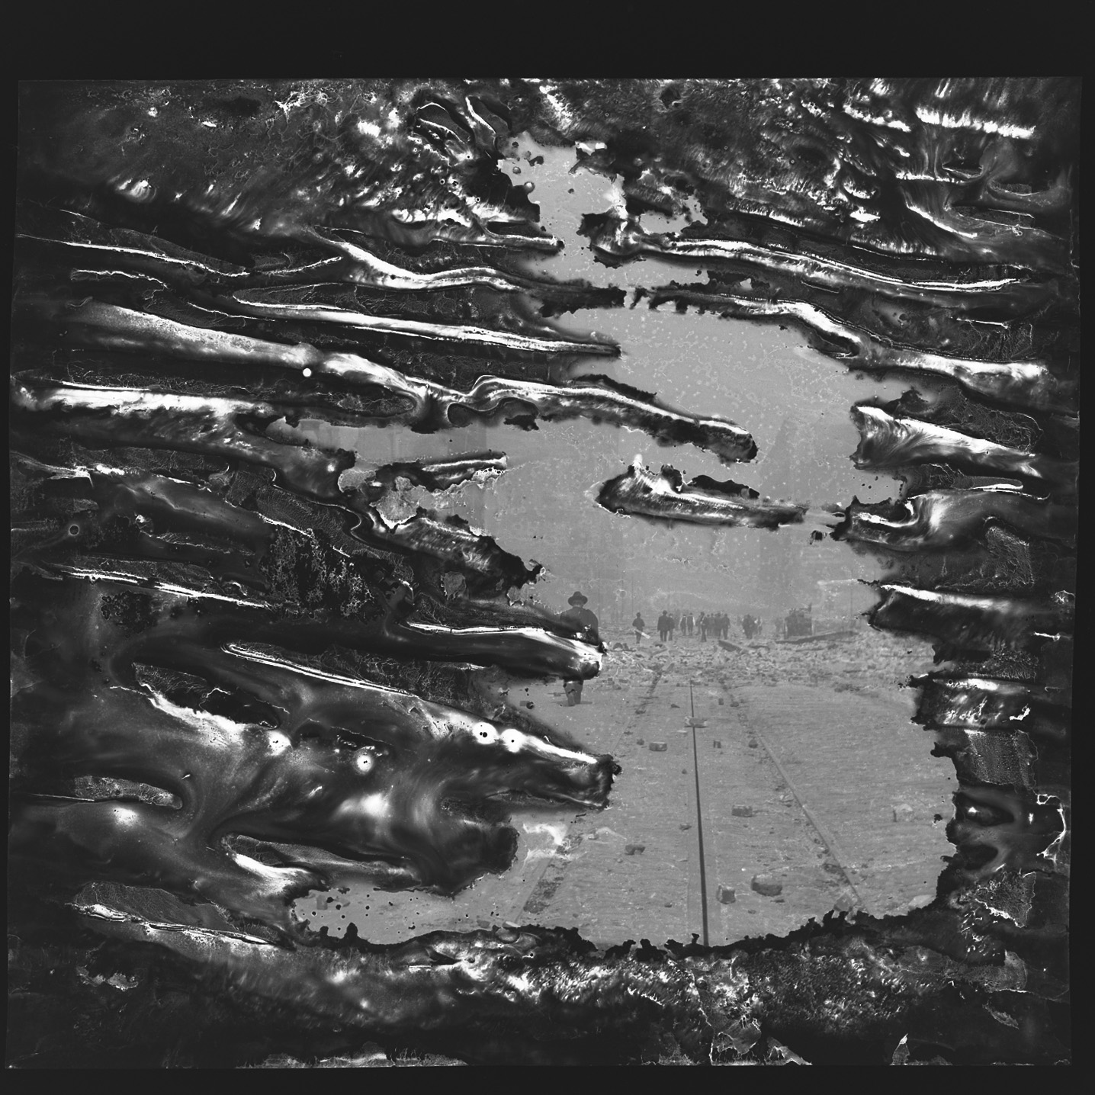
Mold and water damage
Private Collection
1906 Earthquake negatives
Notes:
Mold growth on gelatin can completely destroy or just weaken an image
Mold breaks down gelatin’s complex triple helix / polymer structure allowing it to dissolve rather than gel in water
Changing solubility means that cleaning it is much riskier

Slide 10
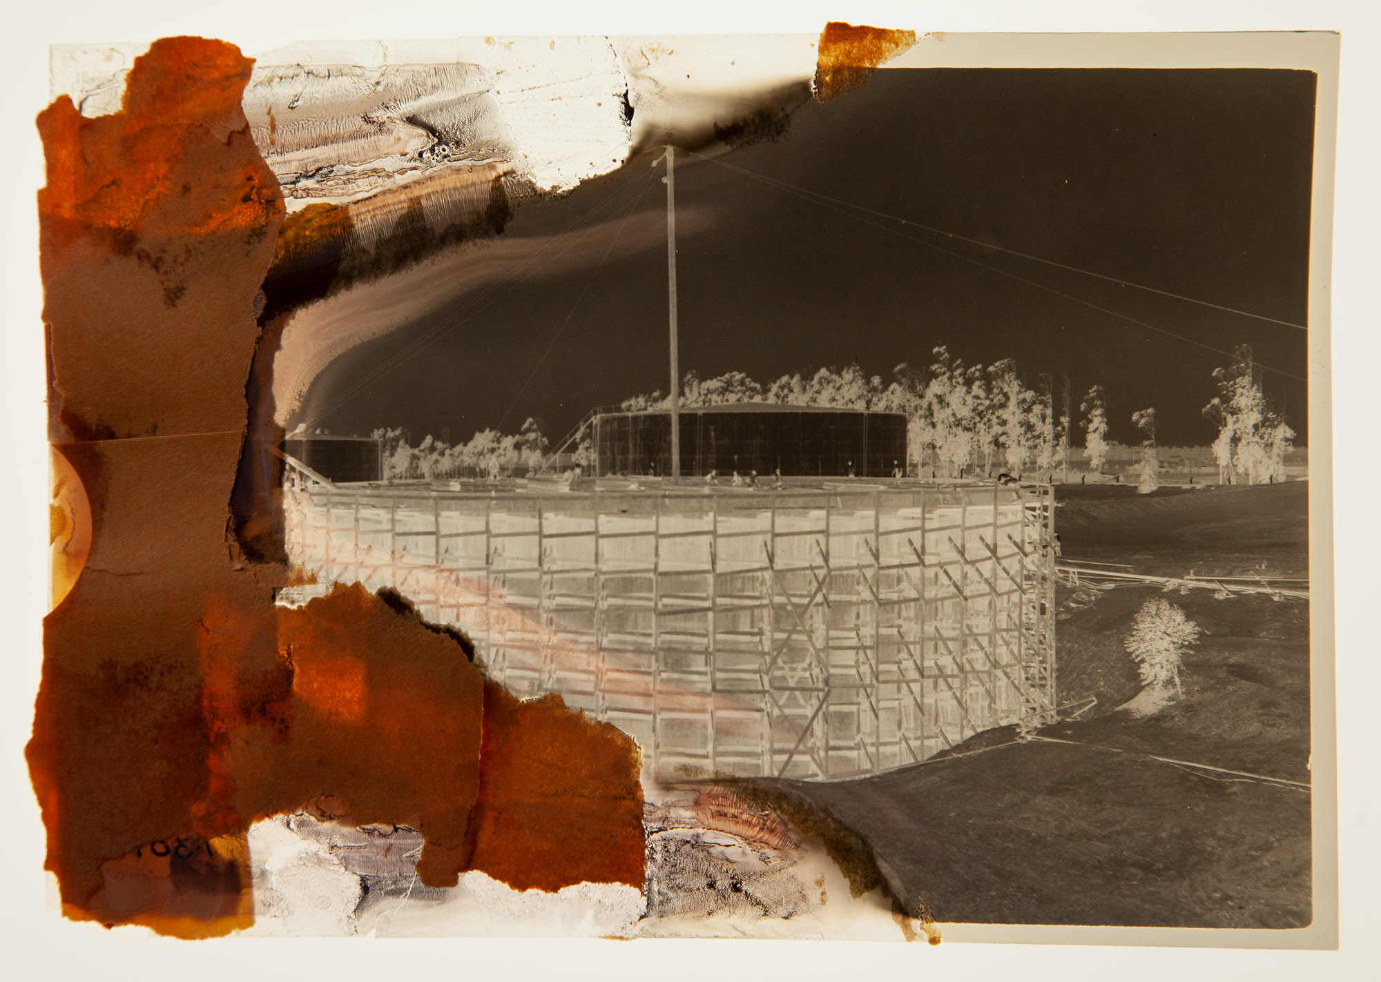
What you can do: TOMORROW
Protect Film w/ DT Film scanning kit
Avoid curved film path or rigid film holders in dedicated film scanners (e.g. Flextight, Coolscan)
Avoid heat
Avoid pressure
Keep negative visible / under your control at all times
AN or AR glass / spacers
Notes:
Protect Film Physically

Slide 11
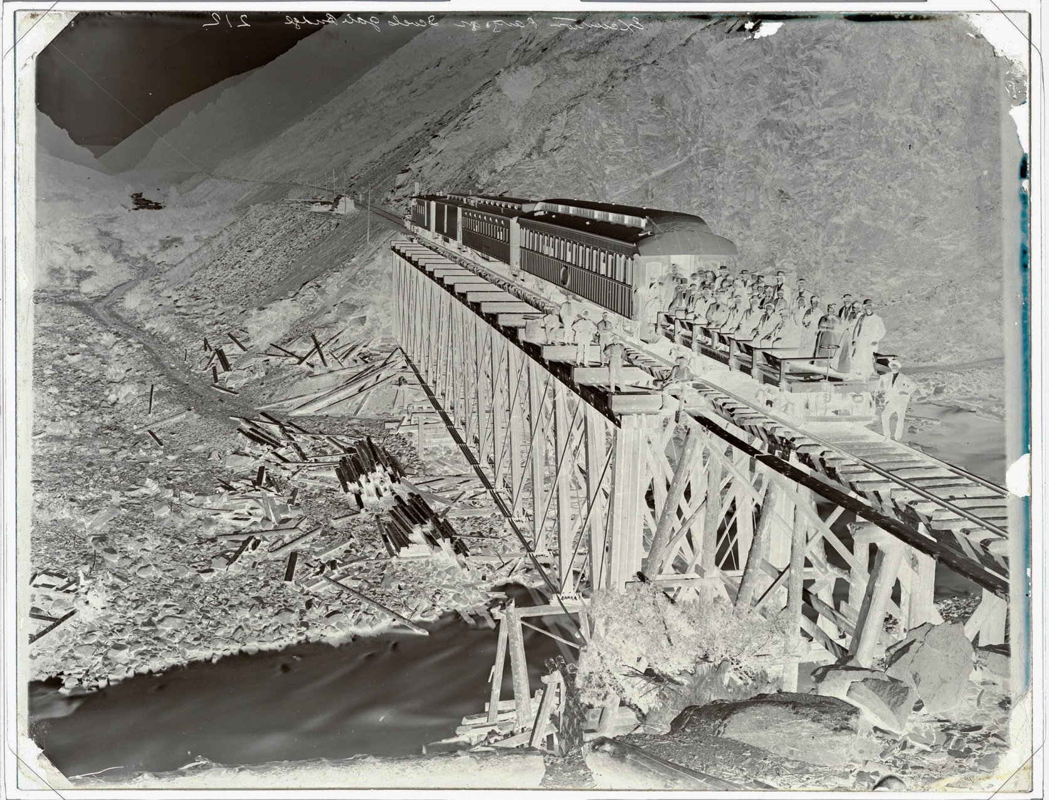
What you can do: TOMORROW
Maximize capture quality and information retention
Capture negative as negative (C1 optimizes this workflow)
Dust removal
  Rocket bulb
  Anti stat gun
  Kinetronics StaticVac
  and similar
Andrew Russell wet collodion negative, Oakland Museum
Iron-based developer
Notes:
What DT calls OBJECT REPRODUCTION MASTER vs CONTENT REPRODUCTION MASTER
Often older/deteriorated film materials are even more important to capture as AS THEY ARE
Good general practice for CH materials, but even more important with older negative materials
--Shows important process characteristics– such as developer and fixer types
--Distinguishes clearly between Deterioration and Image
Andrew Russell wet plate negatives are an extreme example (not film-based) of when showing the original negative is important for scholars in understanding his work

Slide 12
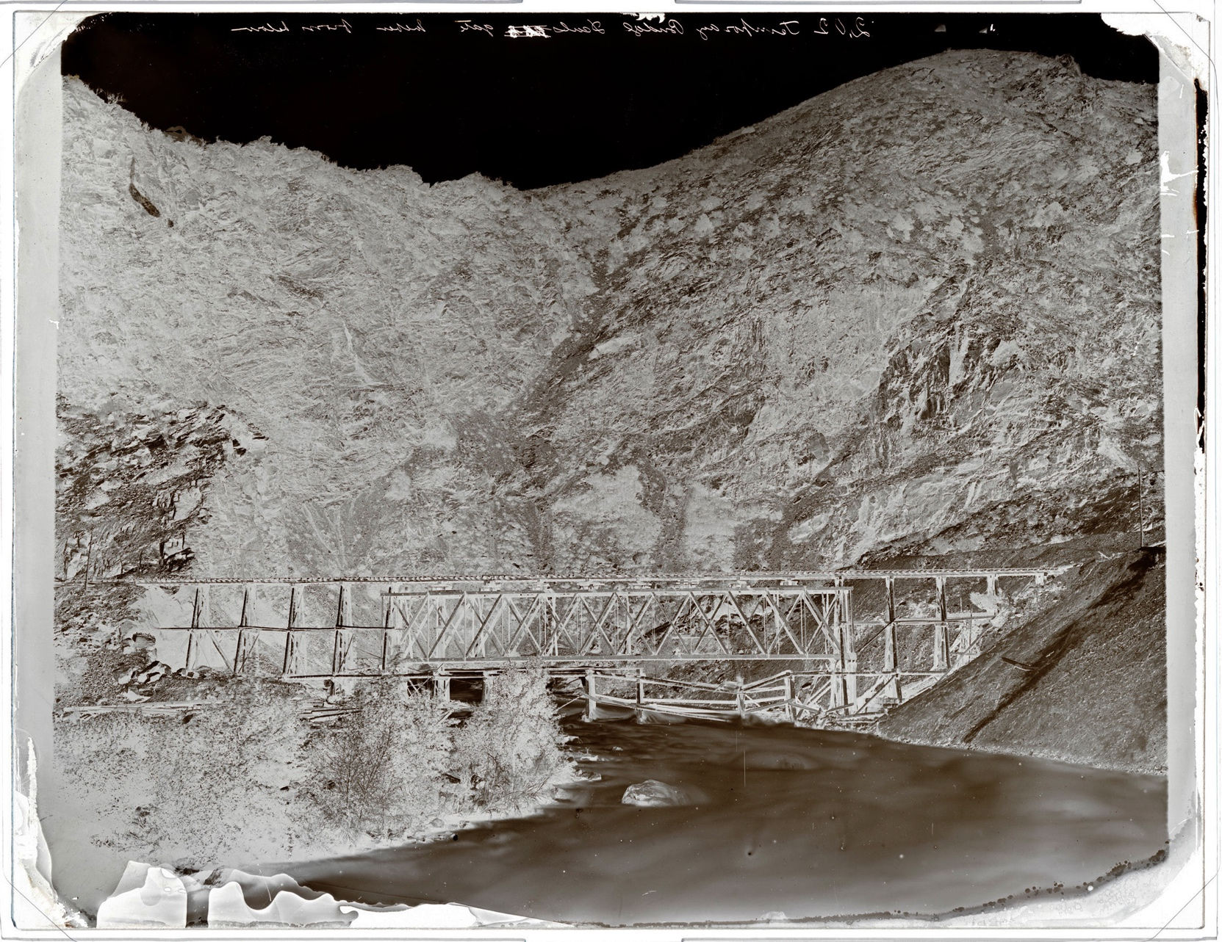
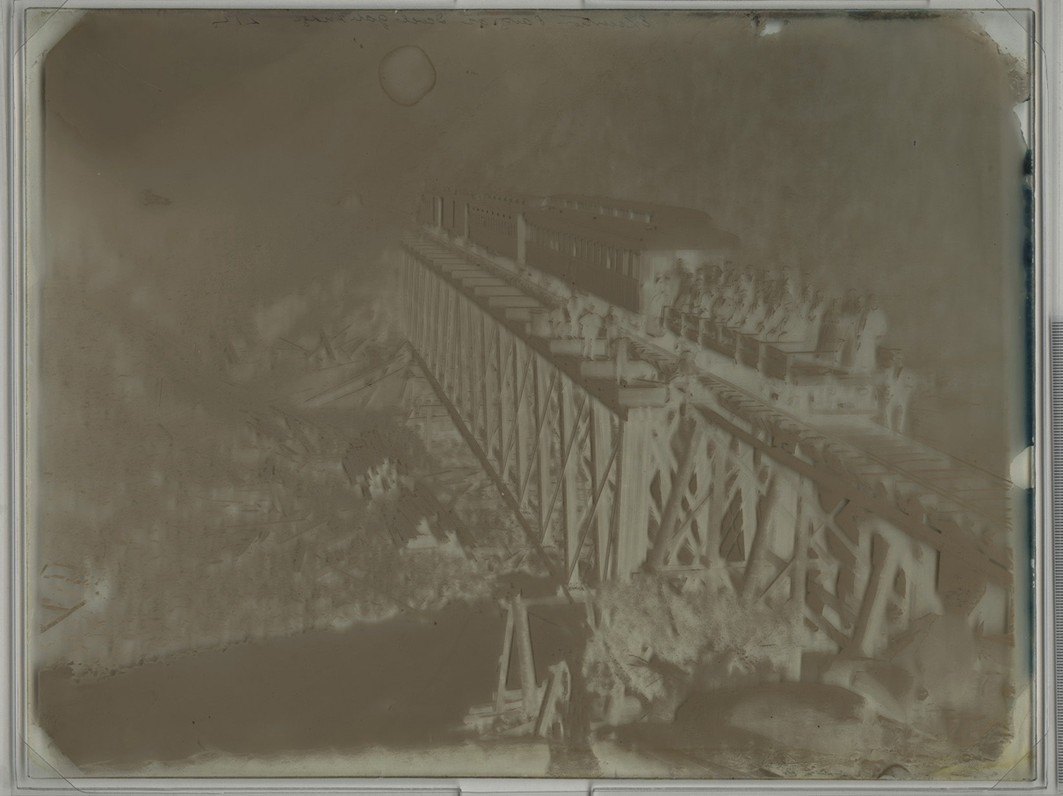
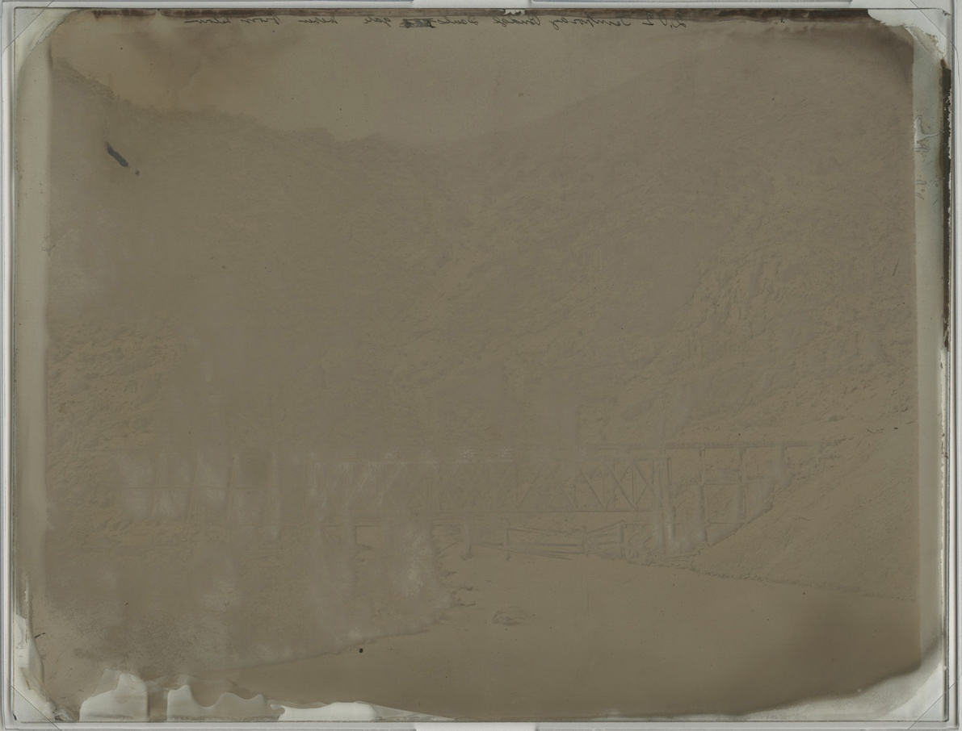
IRON
PYRO
Notes:
OMCA went further and documents transmissive and reflective images of Andrew Russell negatives
Ferrous Sulfate
Fast acting
Less dense negative, often required intensification for printing out papers
Clear shadows
Pyrogallic Acid
Slower acting (restrained to reduce fogging with long development)
Builds greater density, good for printing out papers
More detail in shadows and denser highlights

Slide 13
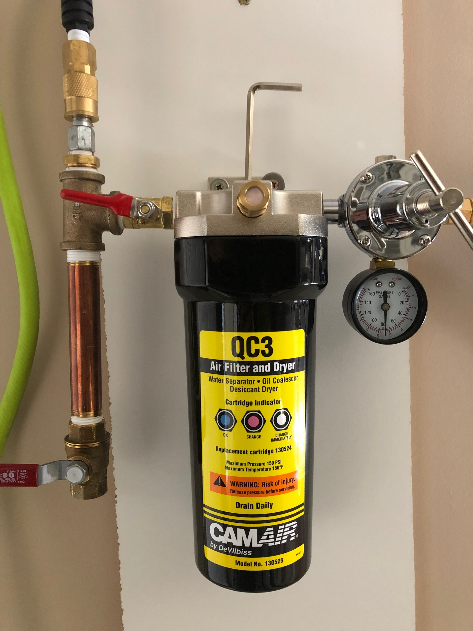
What you can do: TOMORROW
Maximize capture quality and information retention
Capture negative as negative (C1 optimizes this workflow)
Dust removal
  Rocket bulb
  Anti stat gun (caution)
  Kinetronics StaticVac
  and similar
Notes:
Deteriorated negative = dusty often from brittle enclosures

Slide 14
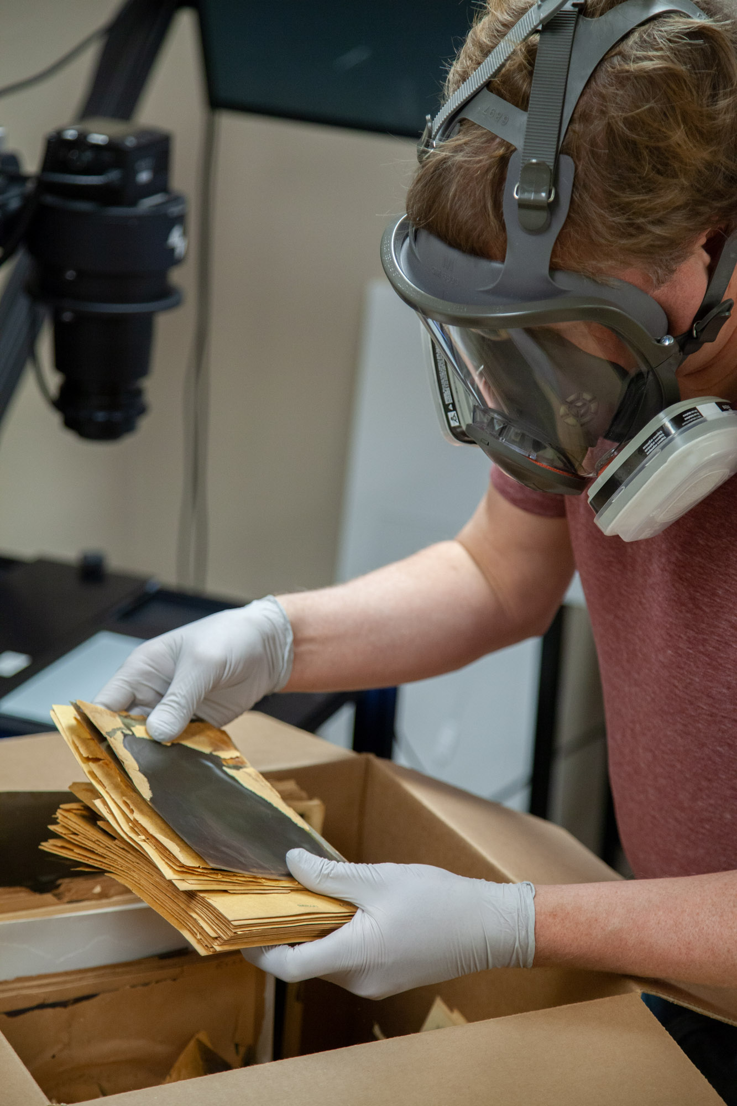
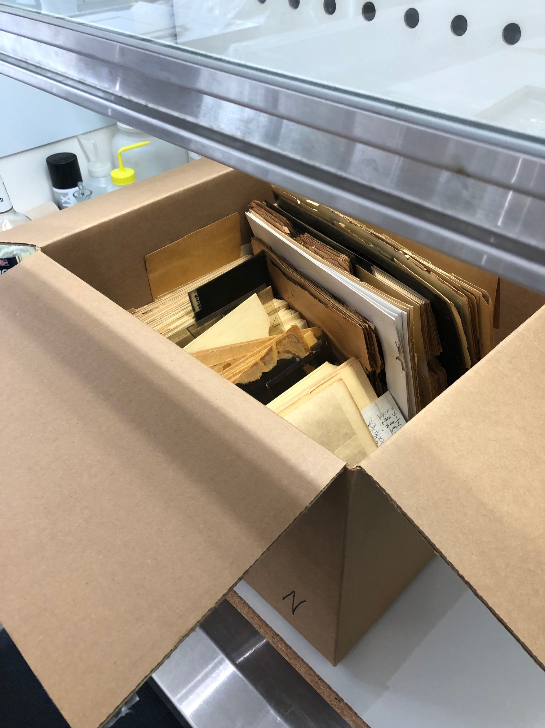
What you can do: TOMORROW
Protect yourself
Avoid fumes
  Ventilation/air exch. (?)
  Elephant trunks (?)
  Full-face respirators (?)
  Fume hoods (!)
Limit quantity of film
Nitrile gloves
Air-out before handling
Notes:
pictur

Slide 15
What you can do: TOMORROW
Protect yourself
Avoid fumes
  Ventilation/air exch. (?)
  Elephant trunks (?)
  Full-face respirators (?)
  Fume hoods (!)
Limit quantity of film
Nitrile gloves
Air-out before handling
Notes:
For smaller quantities nitrile gloves/ and a mask or elephant trunk may be sufficient
(no guarantees– that’s between you and your Industrial Hygienist)
Larger quantities REQUIRE fume hood

Slide 16
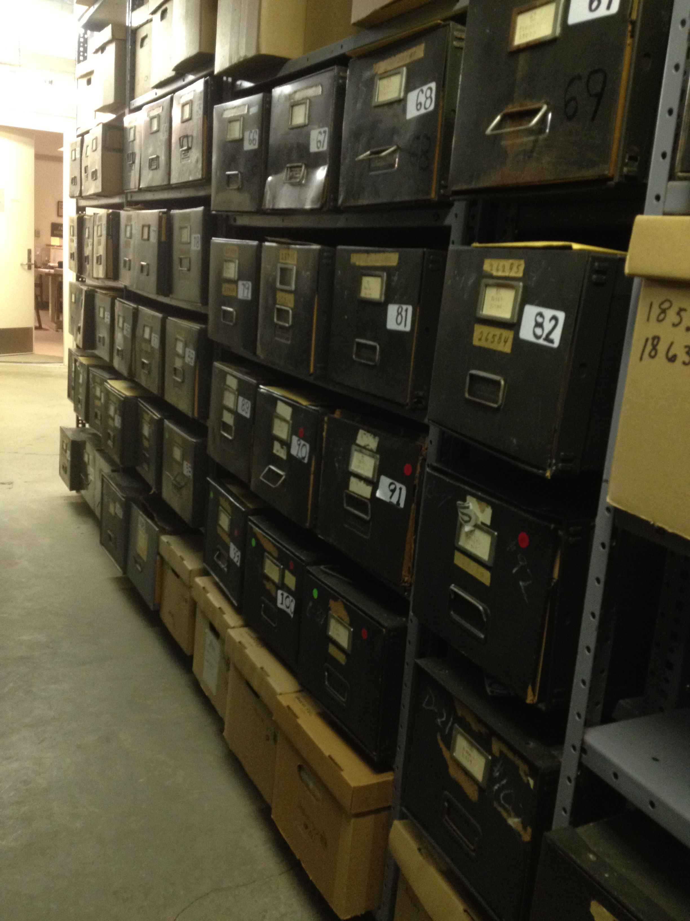
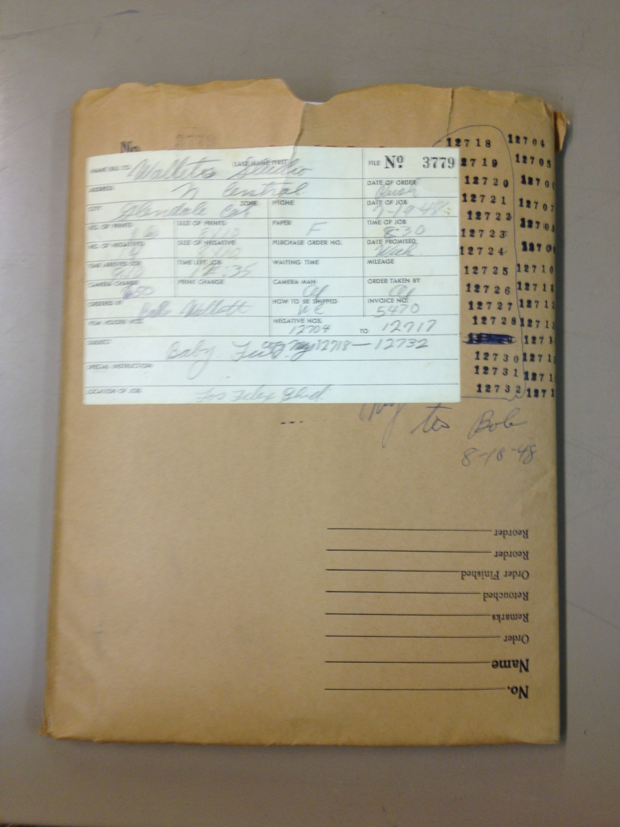
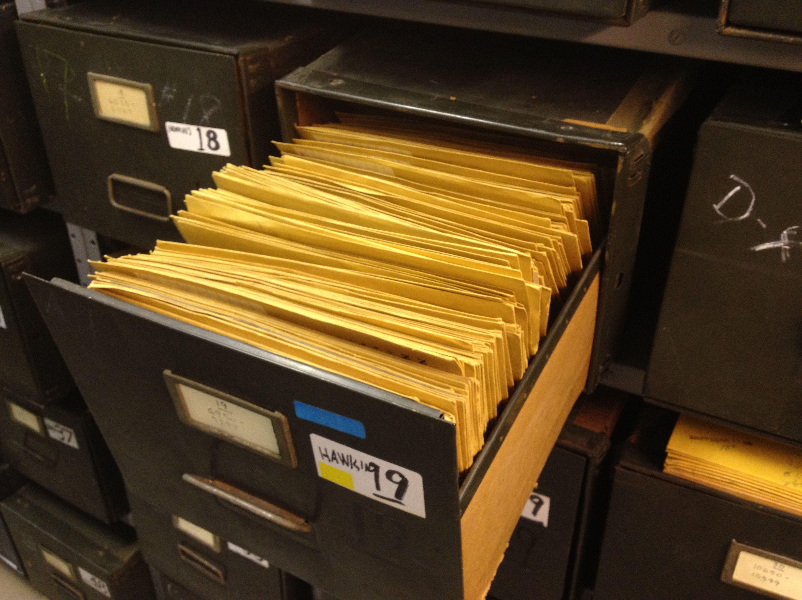
What you can do: LONG-TERM
Rehouse in archival enclosures
Digitize
Freeze
Notes:
Order of operations:
Wrong way: slowly reorganize, Resleeve, digitize, and freeze
Right way: Freeze, then slowly digitize
Consider a perfect archival storage room full of acetate and nitrate
Normal archival standards for documents do not apply!

Slide 17
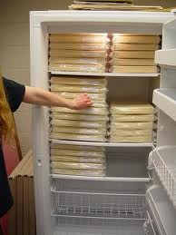
What you can do: LONG-TERM
Freeze first, then digitize
Freezing has many benefits
  Slows all deterioration
  Eliminates harmful off gassing
  Inexpensive (relatively)
  Gives you time
Notes:
Don’t need fancy clean archival boxes

Slide 18
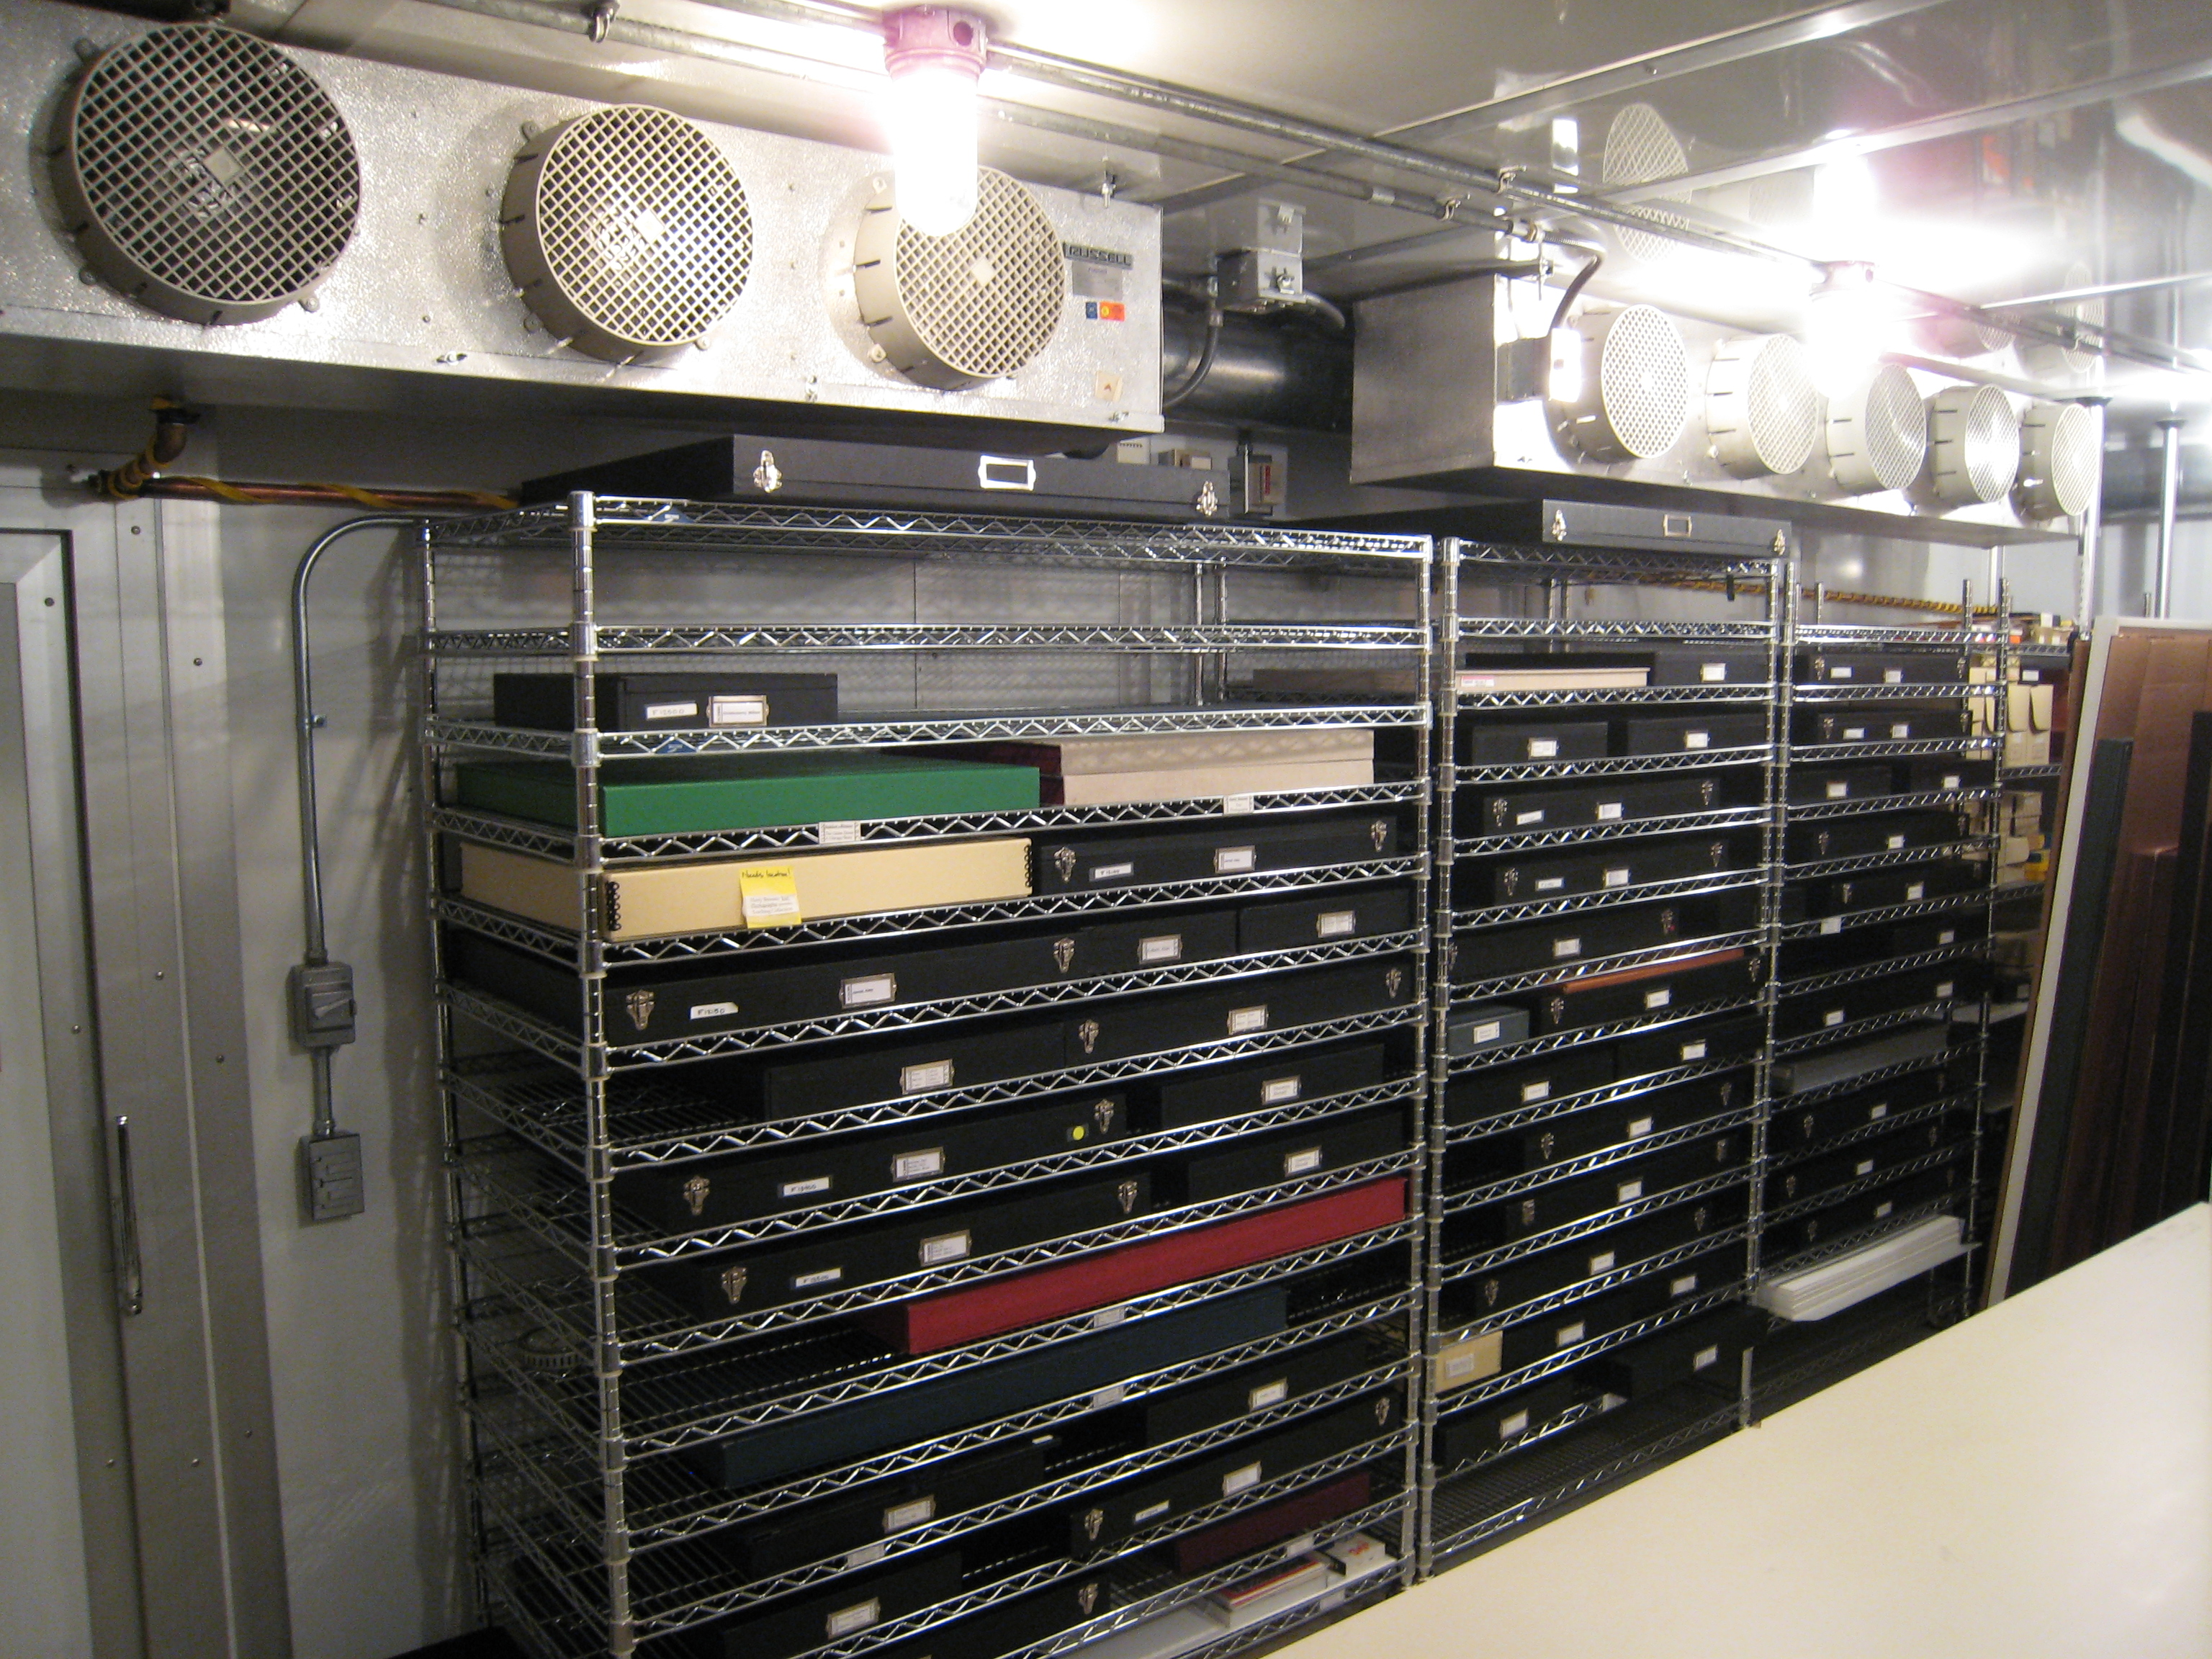
What you can do: LONG-TERM
Freeze first, then digitize
Freezing has many benefits
  Slows all deterioration
  Eliminates harmful off gassing
  Inexpensive (relatively)
  Gives you time
Art Institute of Chicago
Cold Storage Vault
Notes:
Art Institute of Chicago– first photo cold storage vault in the work

Slide 19
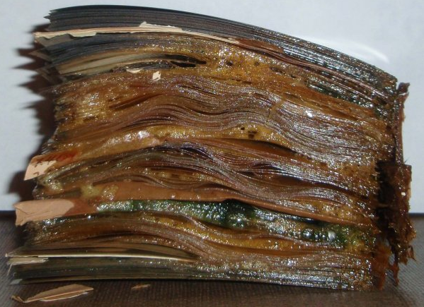
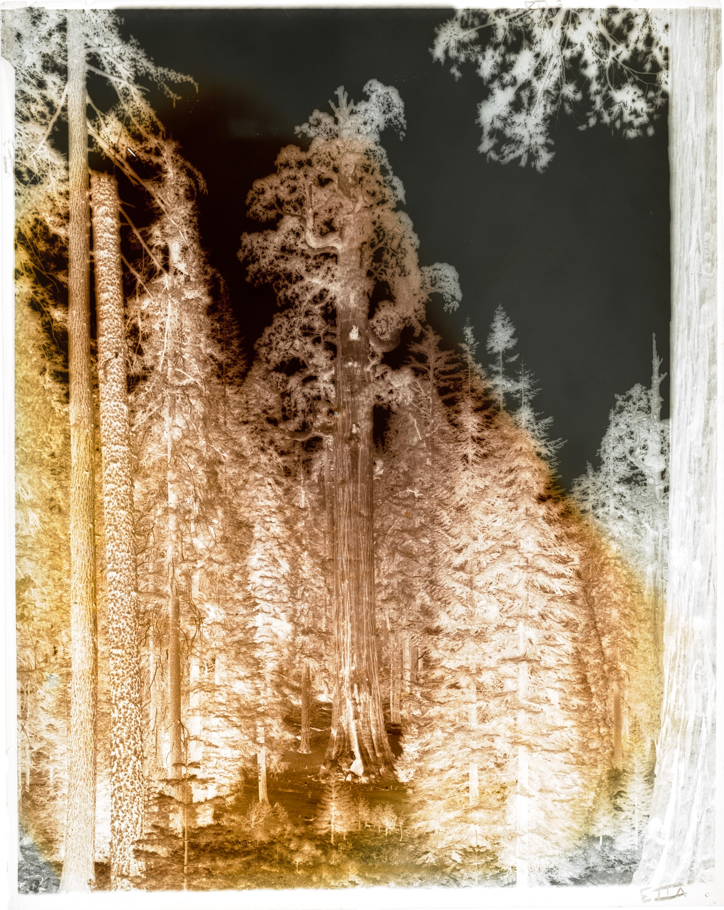
Deteriorated film: OUTSOURCE
All deteriorated acetate or nitrate
Acetate emulsion stripping
Separating stuck film
Tape removal
Cleaning of negatives
Other risky treatments
Notes:
Some of this you may be able to do in-house with the right staff or with some consulting.
But given the challenges and toxicity of nitrate and acetate, you may choose to outsource all of it.

Slide 20
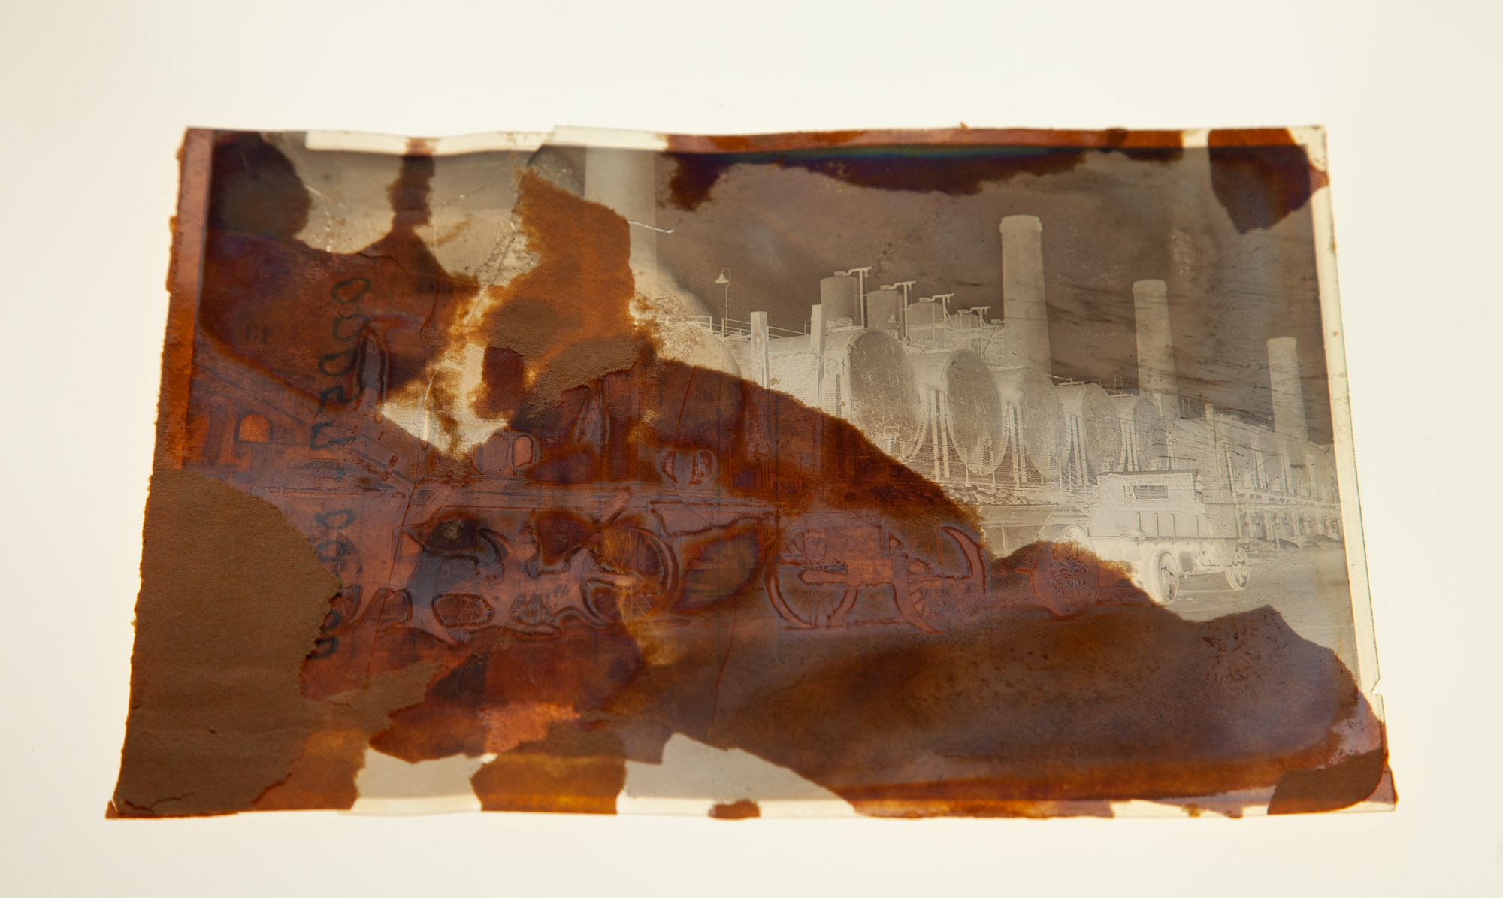
Deteriorated film: OUTSOURCE
All deteriorated acetate or nitrate
Acetate emulsion stripping
Separating stuck film
Tape removal
Cleaning of negatives
Other risky treatments
Notes:
With nitrate sometimes there’s only so much that can be saved

Slide 21
Deteriorated film: OUTSOURCE
All deteriorated acetate or nitrate
Acetate emulsion stripping
Separating stuck film
Tape removal
Cleaning of negatives
Other risky treatments
Notes:
With Acetate, even extreme vinegar syndrome can usually be recovered from….at a cost.
Cost of emulsion stripping -- one reason why freezing is less expensive

Slide 22
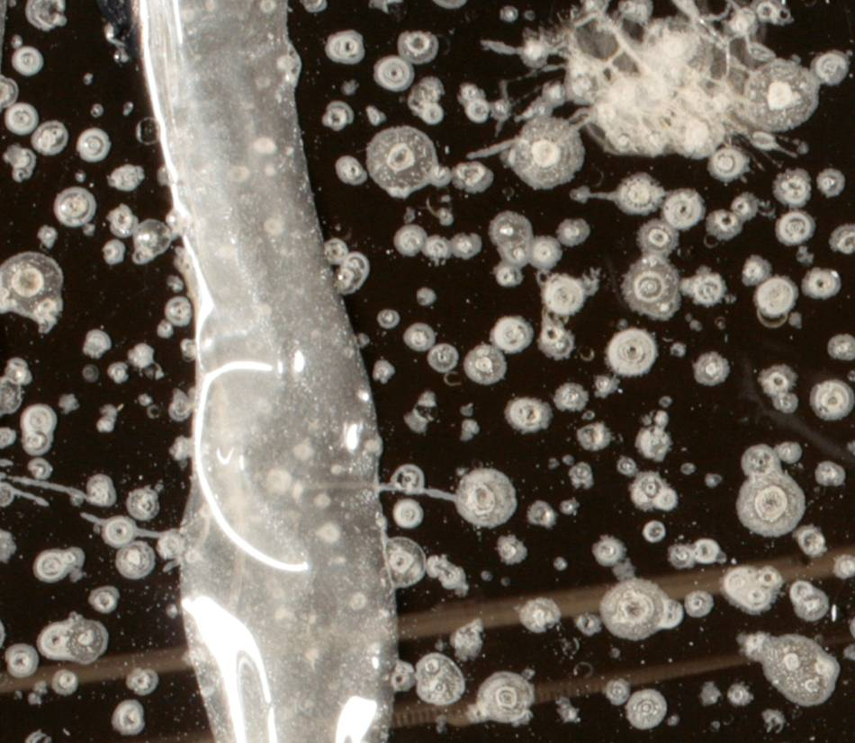
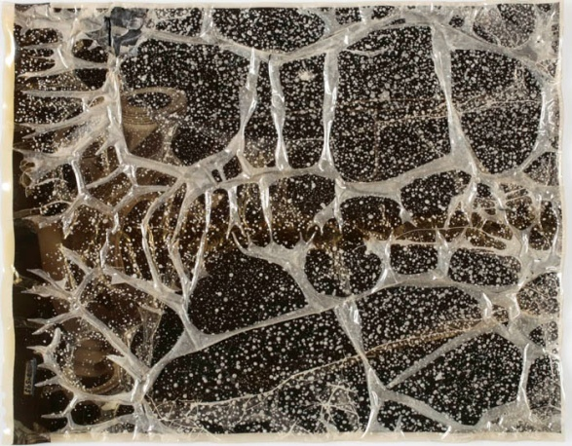
Plasticizer exudation from degrading film
Phthalate plasticizers
Liquid-filled bubbles

Slide 23
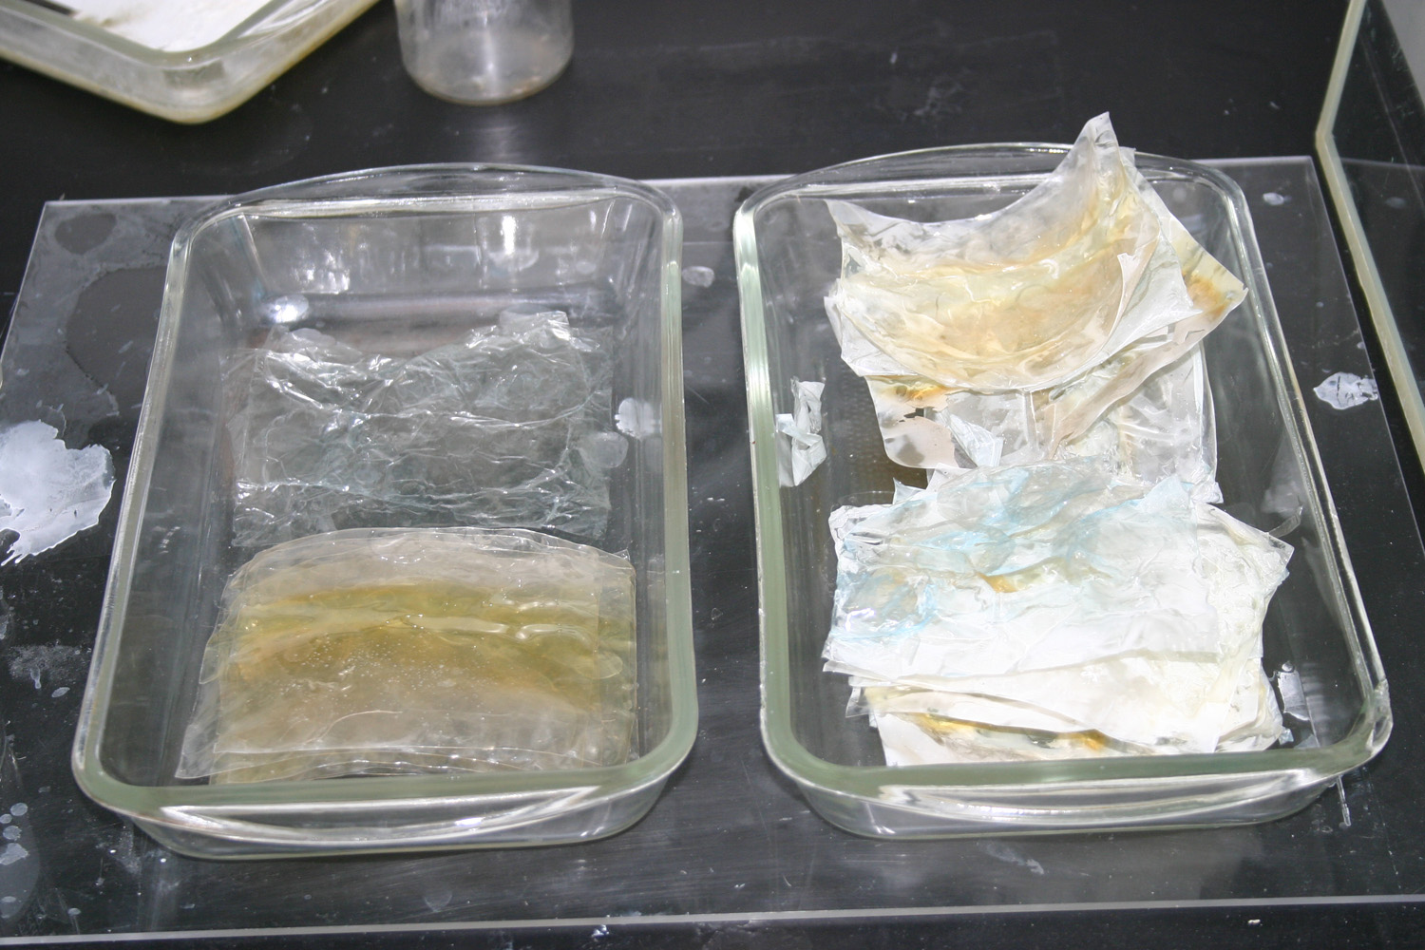

Slide 24
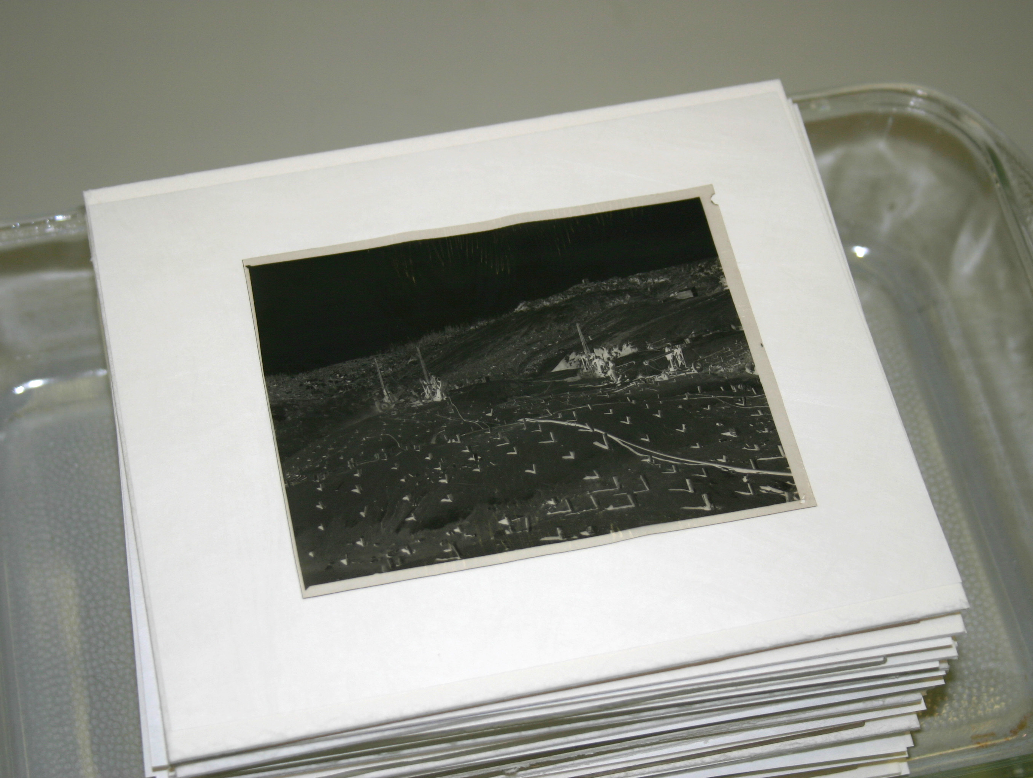
Notes:
Acetic acid is a weak acid and does not attack gelatin or silver
Treatment is possible

Slide 25
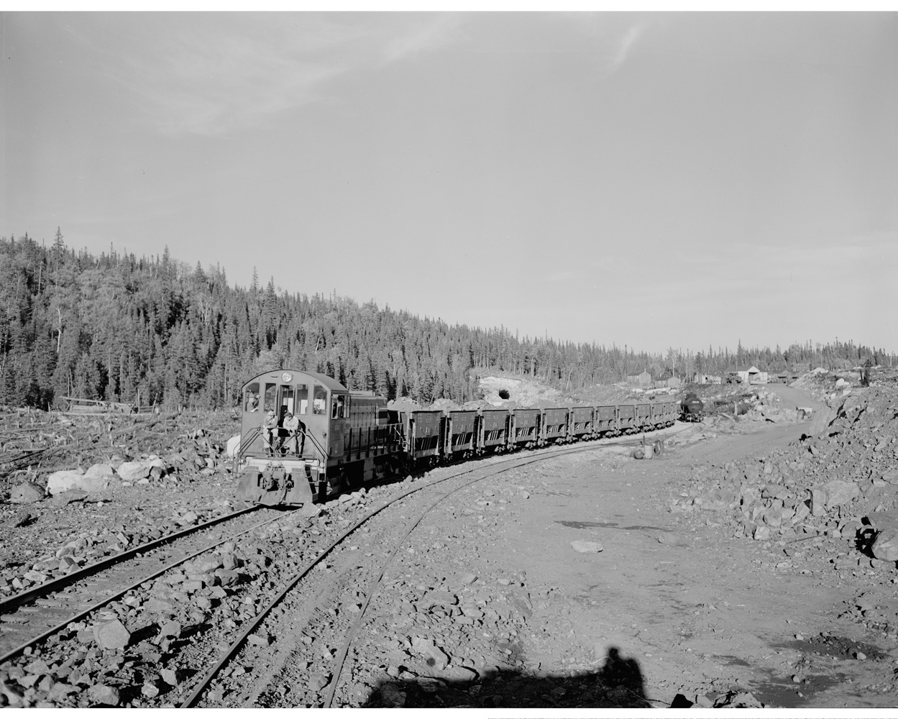
Notes:
Show & Tell: stripped pellicle

Slide 26
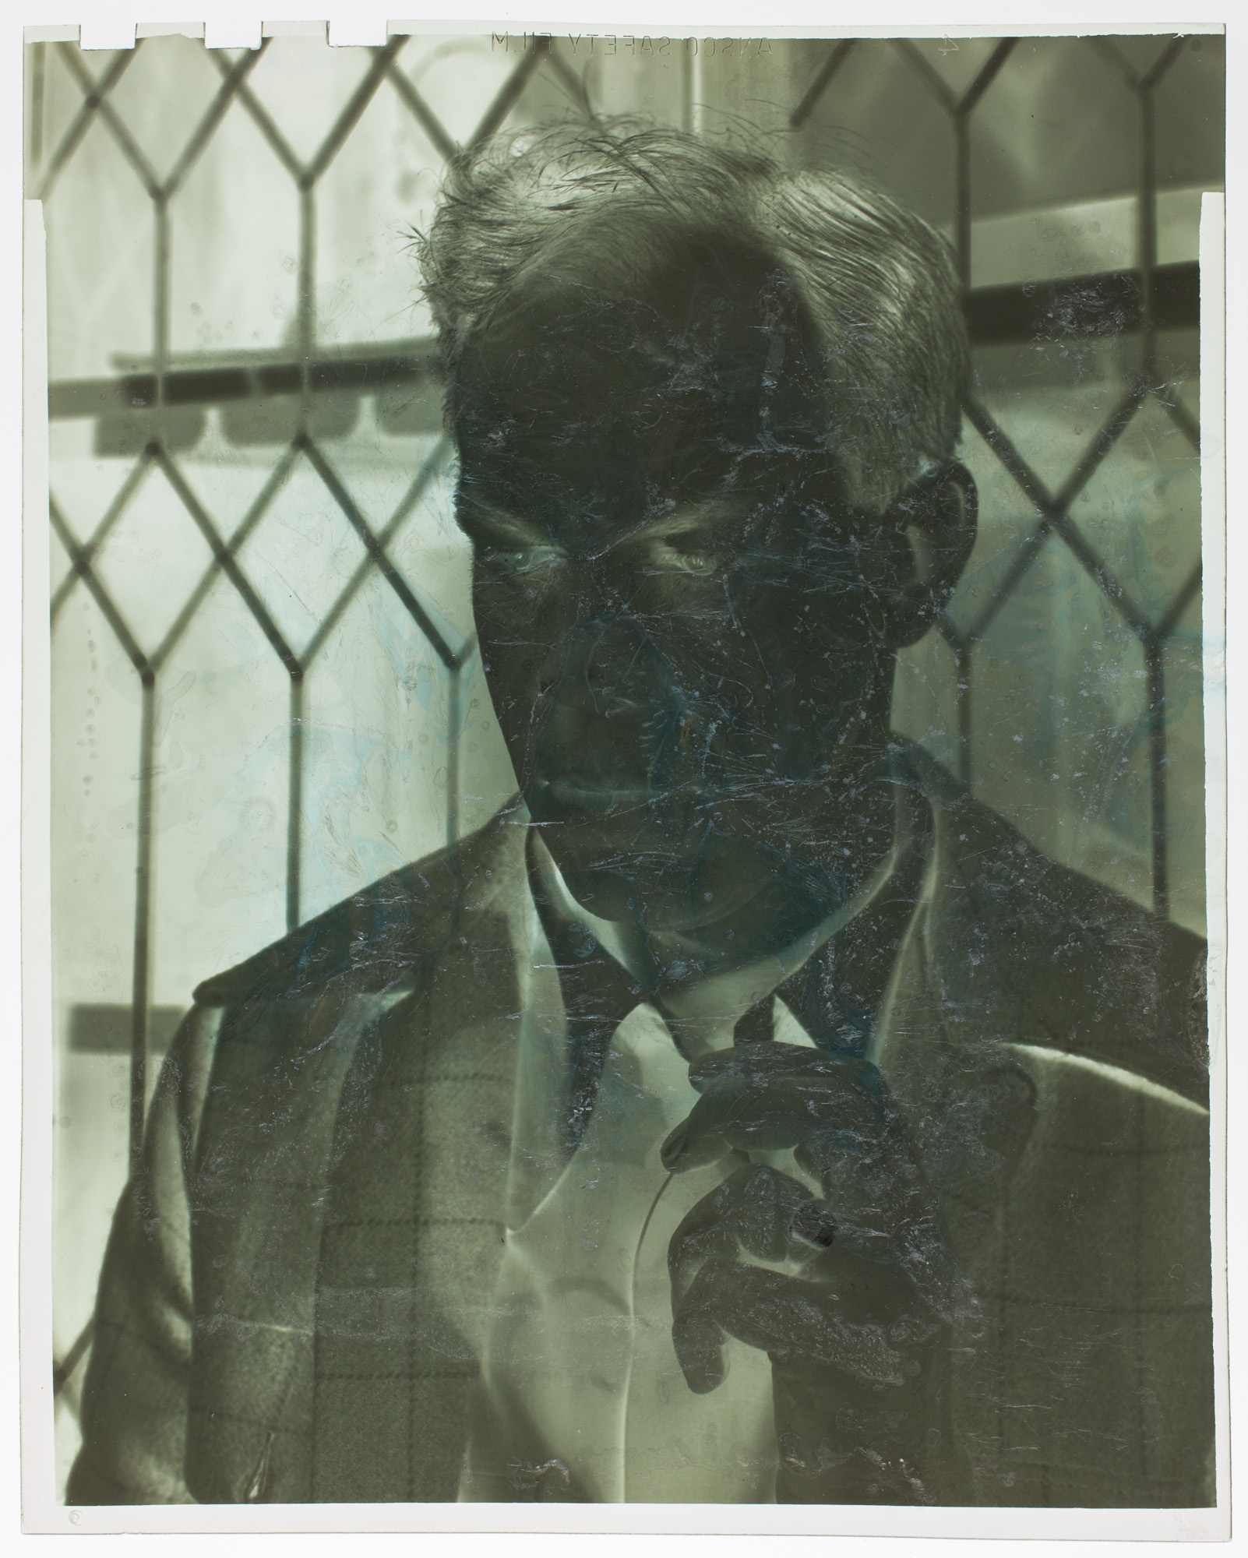
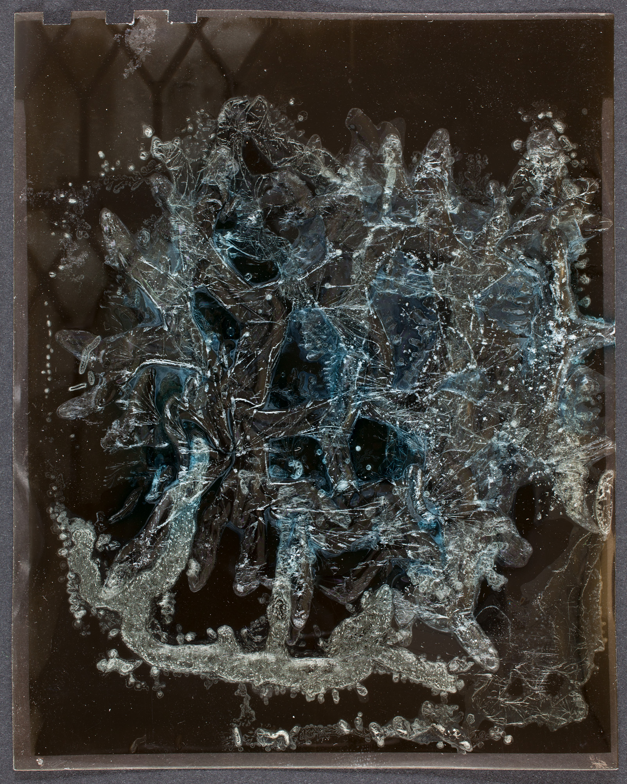
Notes:
Minor White by Rose Mandel
One of her teachers at the California School of Fine Arts (now SFAI) where she studied photography

Slide 27

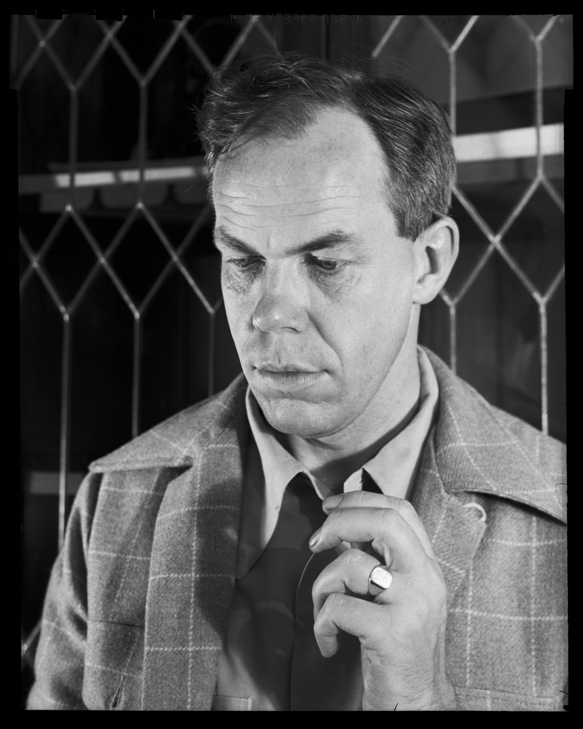
Notes:
Minor White by Rose Mandel
One of her teachers at the California School of Fine Arts (now SFAI) where she studied photography

Slide 28
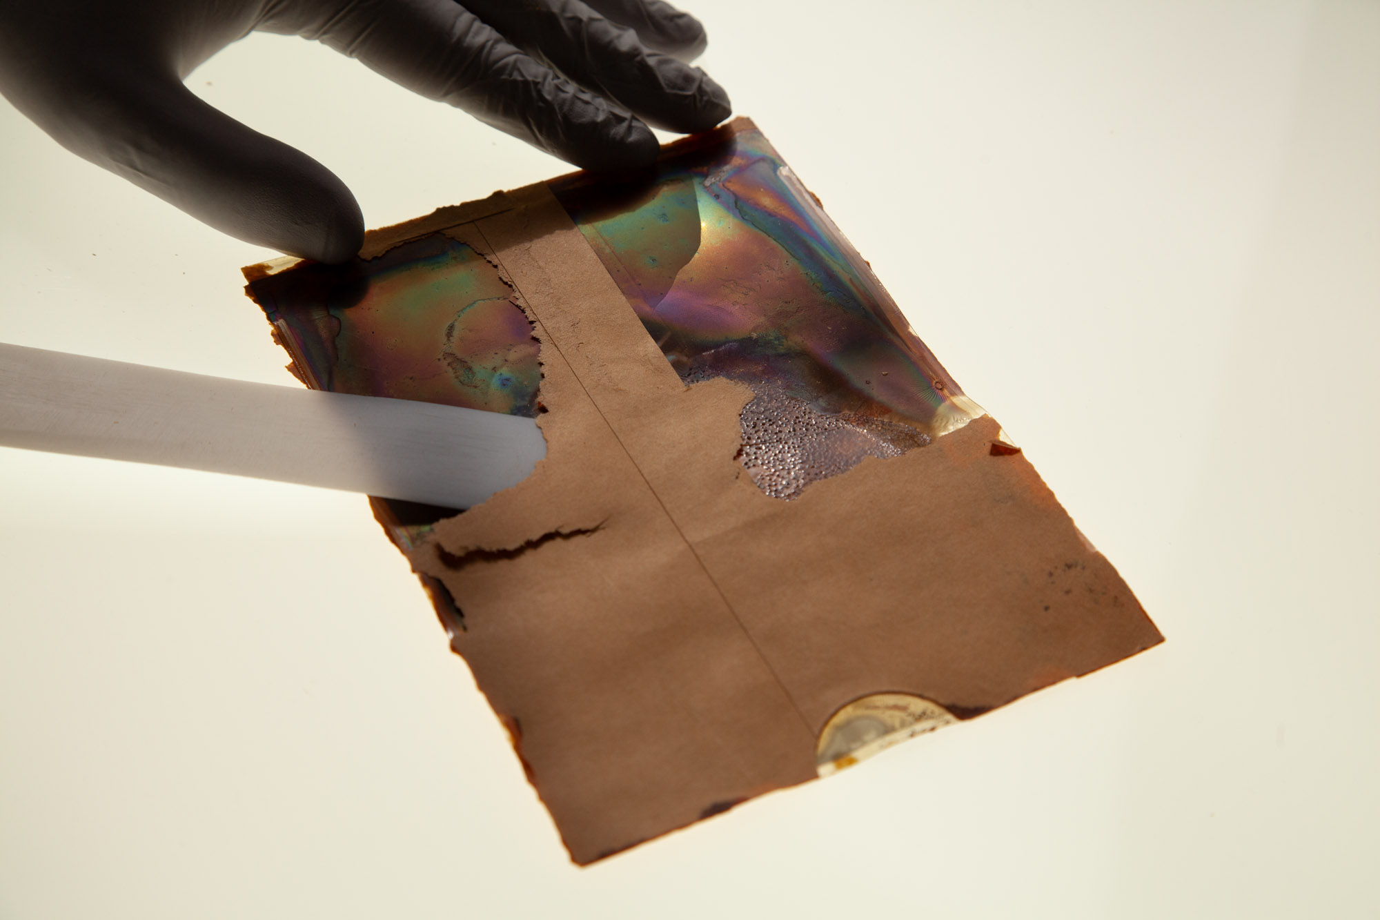
Deteriorated film: OUTSOURCE
All deteriorated acetate or nitrate
Acetate emulsion stripping
Separating stuck film
Tape removal
Cleaning of negatives
Other risky treatments
Notes:
Whether film to paper or film to film the negatives can sometimes be saved

Slide 29
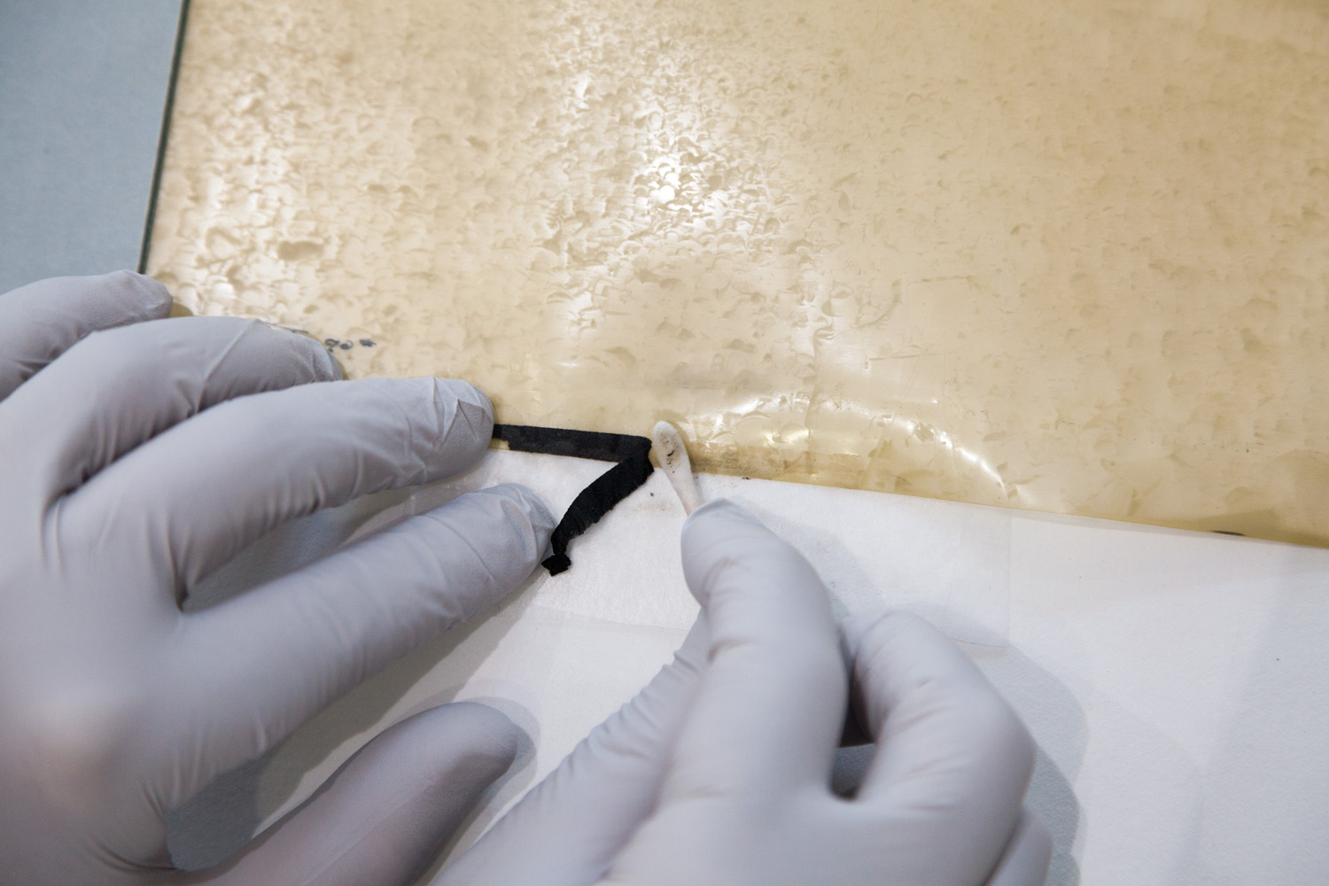
Deteriorated film: OUTSOURCE
All deteriorated acetate or nitrate
Acetate emulsion stripping
Separating stuck film
Tape removal
Cleaning of negatives
Other risky treatments
Notes:
Water-activated, pressure-sensitive, rubber cement– many kinds of tapes and adhesives have been used.
Sometimes they obscure image.

Slide 30
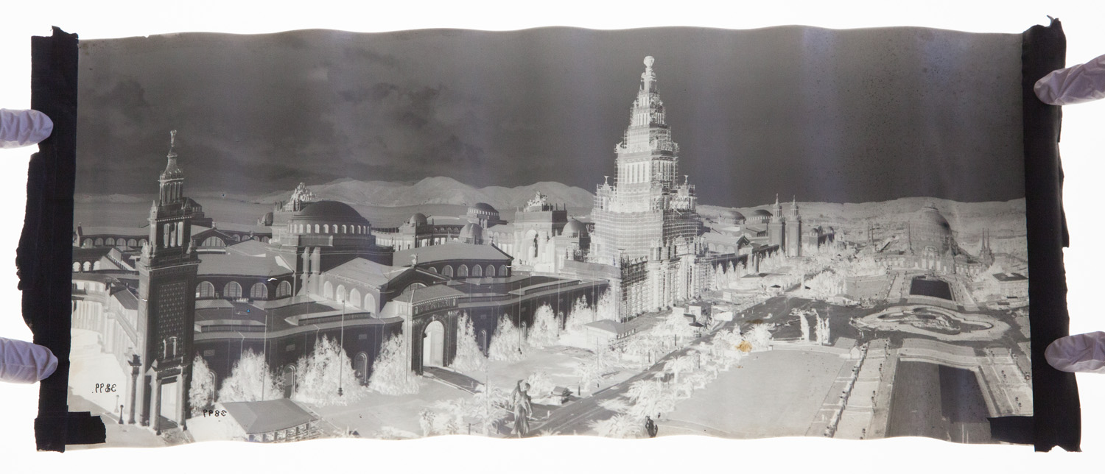
Conservation: tape removal
PPIE, Cirkut panorama, Bancroft Library
Black paper tape with water-activated adhesive used during print production
Often covered image
Safely removed with humidification by poultice or damp blotters & Gore-Tex
Notes:
Emulsion stripping is a fairly extreme treatment to save negatives.
Most of the time simple cleaning or tape removal is sufficient
REVEAL the image by cleaning, rather than digitally fix later.
Cleaning improves image quality, saves time, and preserves the negative by removing dirt and accretions that can cause damage over time.
Though we do plenty of work that is just conservation or just digitization, some of our most satisfying projects are when we can do both– conservation cleaning, tape removal, flattening, etc and THEN rapid digital capture.

Slide 31
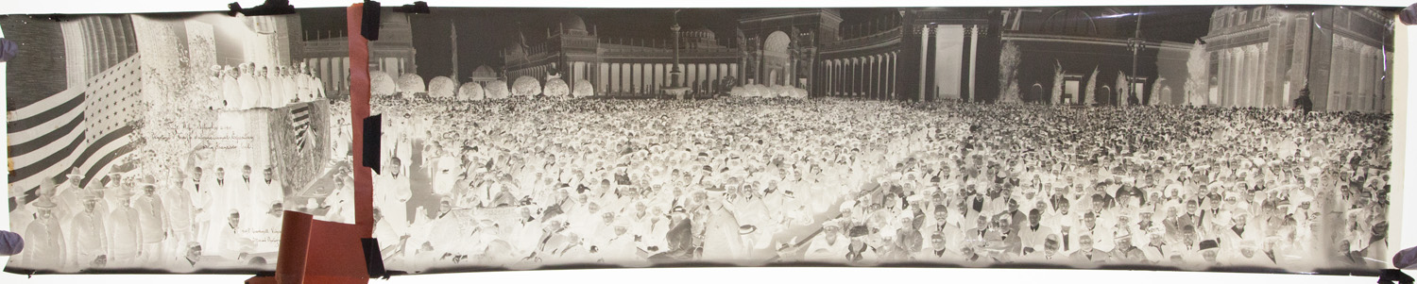
Conservation: tape removal
PPIE, Cirkut panorama, Bancroft Library
Black paper tape with water-activated adhesive used during print production
Often covered image
Safely removed with humidification by poultice or damp blotters & Gore-Tex

Slide 32
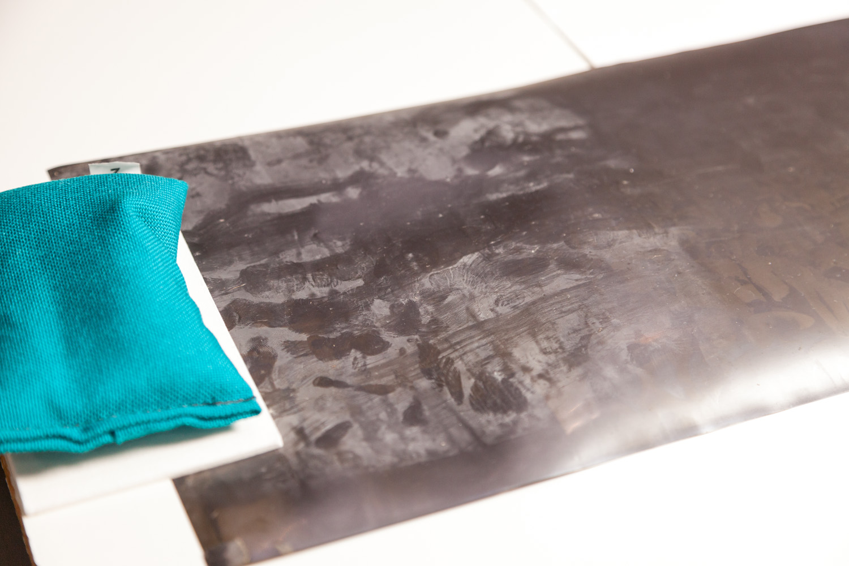
Deteriorated film: OUTSOURCE
All deteriorated acetate or nitrate
Acetate emulsion stripping
Separating stuck film
Tape removal
Cleaning of negatives
Other risky treatments
Notes:
Cleaning of negatives is a whole lecture in and of itself…water, alcohol, other organic solvents…
The trick is dissolving the dirt but not the negative…
And deteriorating negatives have altered solvent sensitivities as they chemically decay, so each one is a little different.

Slide 33
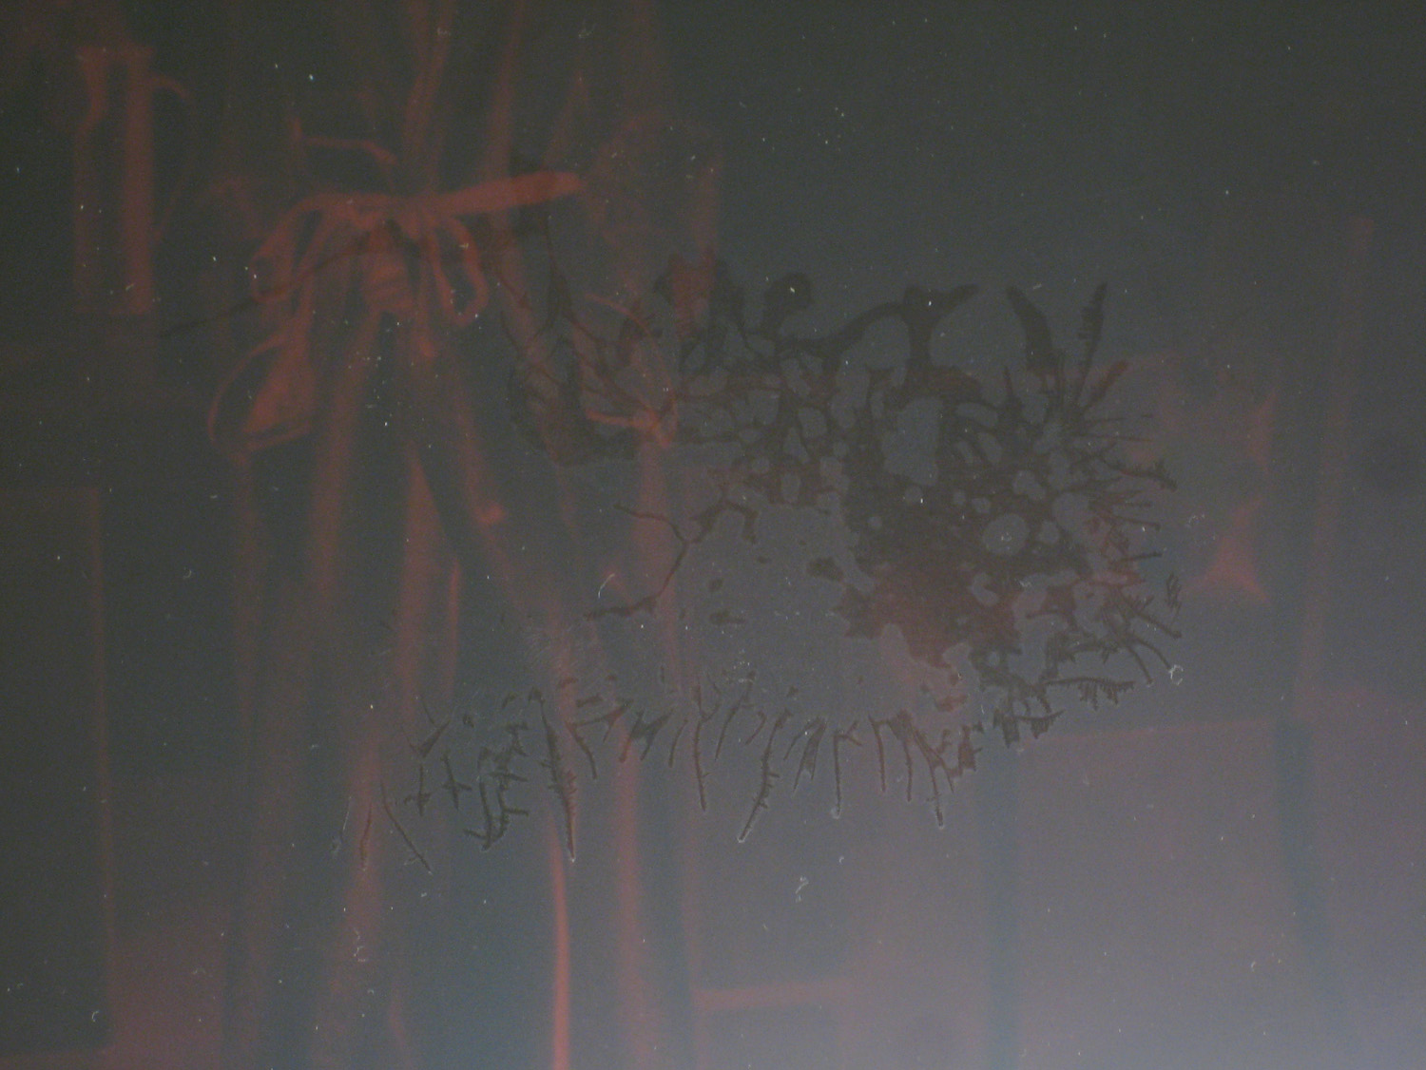
Deteriorated film: OUTSOURCE
All deteriorated acetate or nitrate
Acetate emulsion stripping
Separating stuck film
Tape removal
Cleaning of negatives
Other risky treatments

Slide 34

Notes:
Stay in touch with my very occasional newsletter…

Slide 35


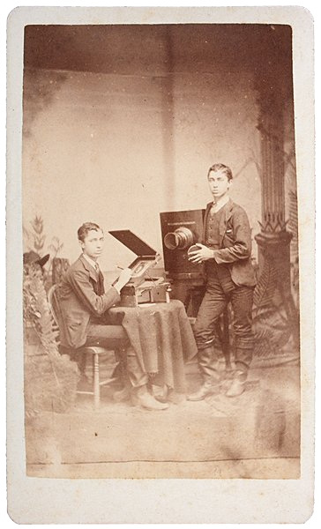
gawainweaver.com • twocatdigital.com
gw@gawainweaver.com
18 Greenfield Avenue, San Anselmo, CA 94960
415-446-9138

